Slide 1
The Limitations with “Debunking” and “Lateral Reading” Strategy: The Evaluation Strategy Re-evaluated in the Age of Infocracy
Richard M. Cho
CCLI 2025, May 30th

Slide 2
Richard M. Cho
Subject Headings:
Information Literacy
(Mis)information
Neoliberalism
Smart-phone
Info Lit Pedagogy
Democracy
Research Librarian for Humanities and Literature
@ UC Irvine

Slide 3
Disclaimer
Experimental - research mainly outside of library science literature
Acknowledgement of our info lit session limitation
One-time, Usually 50 minutes
Instructor expectations

Slide 4



Approach
Current political-economic condition
Students in 21st century
Misinformation in this context
Librarian’s Information Literacy Instruction
Definition
Socially Strategic Expression
Information —> narrative

Slide 5
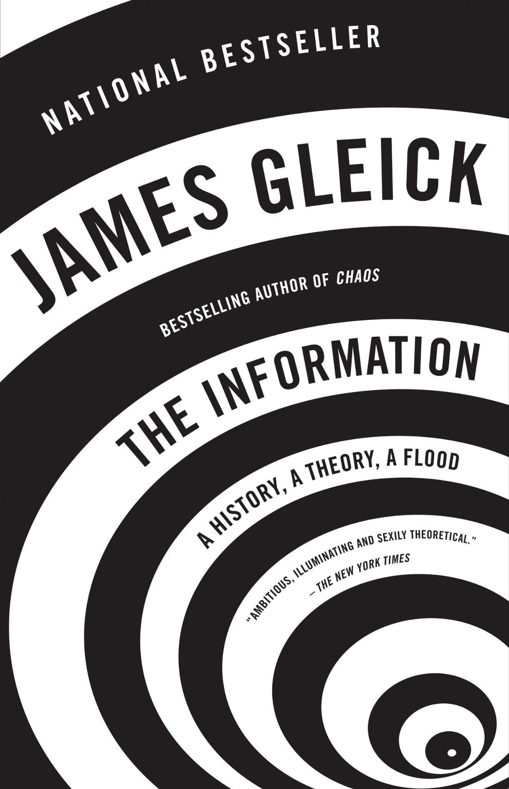
Information

Slide 6
Data presented in readily comprehensible form to which meaning has been attributed within the context of its use. In a more dynamic sense, the message conveyed by the use of a medium of communication or expression. Whether a specific message is informative or not depends in part on the subjective perception of the person receiving it. (Online Dictionary for Library and Information Science)
Something that attempts to represent “reality” to the receiving mind
Notes:
Traditionally…

Slide 7
Information as something that connects disparate units into a network to create a new reality. It connects, rather than represents. (Information has no essential link to truth.)
Notes:
McLuhan book & Harari books

Slide 8
Bits circulating in a hyper-real space with minimal (or no) reference to reality. Its main function is neither to represent nor to connect, but to stimulate.

Slide 9
Represent
Connect
Stimulate
What “information” does…

Slide 10
What is driving this change (or added characteristics) in the definition of “information?”

Slide 11
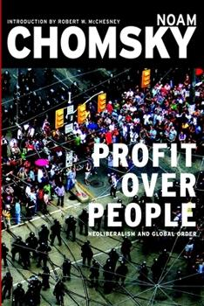
Neoliberalism
Notes:
Define it? =)

Slide 12
What is it?
A pronounced tendency among scholars to interpret neoliberalism as entailing the rise of free markets & the corresponding retreat of the state.
But! The state has played an integral role in constituting neoliberalism
It is on corporations, not markets, that people (and states) have come to depend under neoliberalism
Privatization & deregulating
A set of social, cultural, and political-economic forces that puts competition at the center of social life.
Hyper-individualism: but human beings need social cooperation & a commitment to a common, collection good. (Breakdown of a community)
Faster Production, more consumption, 24/7 communication
Private affluence, public squalor

Slide 13
Neoliberalism
Anxiety (ceaseless competition)
Insecurity
Increasing Inequality (scarcity, corporation)
All human values are commercialized and subjected to economic imperatives
Consequences for the general public mass
Notes:
… society is increasingly atomized and narcissistic. This also leads to a loss of empathy.

Slide 14
What has it got to do with information literacy?
Hyper-competitive society (how would our students react to this)
Communication Technology (smartphones and A.I., all in the service of neoliberalism [faster communication, more consumption, etc.)
The proliferation of the conflict of epistemologies (fake news)
How the era of neoliberalism changed the nature of information..
Production of information for consumer generation (buyers/users)
Information as stimulant (attention economy)
De- narrativization (information as scattered dots)

Slide 15
Digitalization, Datafication…
Information now circulates in a hyper-real space, without much reference to reality. After all, fake news is a kind of information, and one that is possibly even more effective than facts. What counts is short-term effect. Effectiveness replaces truth.
Big data
“Datafication” - converting “human practices into computational artefacts” - promotes neoliberalism, automates inequality, and decreases freedom.
Notes:
Another pathology, digitalization of everything…

Slide 16
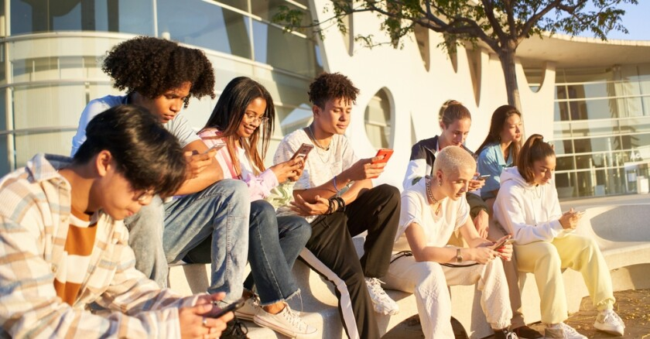
Our Students

Slide 17
Misinformation
Misinformation often serves to rationalize pre-existing inclinations rather than cause them. (e.g. presidential election.)
Misinformation largely preaches to the choir
Lack of access to reliable information plays a negligible role (rather, partisanship & identity)
Are we misinformed
about how to fight misinformation?

Slide 18
Neoliberal Regime
Feel uncertain & powerless
Marginalized victims
A lack of interpersonal trust
A sense of alienation
Fraying sense of institutional integrity
Hyper-competitiveness
What are the social conditions that make us susceptible to misinformation?
Notes:
Our students nowadays may feel all of these…

Slide 19
Socially Strategic Expressions
We seek, use, share “information” to effectively interact with the world
Accepting in certain “information” often function as a badge: group identity
But! Because we treat misinformation as a problem of human gullibility, the remedies we propose tend to focus on minor issues, while ignoring the larger social forces and human tendencies that drive the phenomenon.

Slide 20
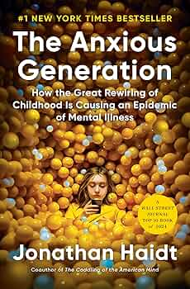
Smartphones

Slide 21

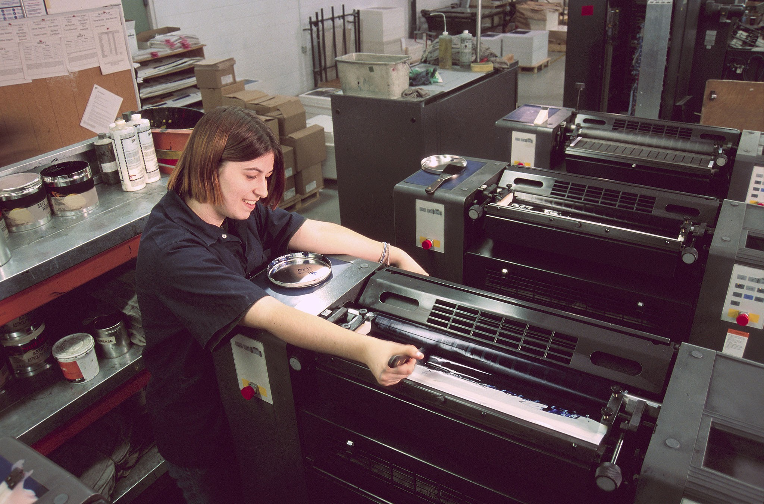

Information Technology
?????
Writing (5000 years)
Printing Press (500 years)
Radio/Television(100 years)
Comp./Internet (50 years)
Smartphone (15 years)
????? (5 years)

Slide 22
??????
300,000 Years ago
Printing Press
500 Years ago
Internet
50 Years ago
And A.I.
20XX
Writing
5,000 Years ago
Radio/Television
100 Years Ago
Smartphone
15 Years ago
Information Technology Timeline

Slide 23
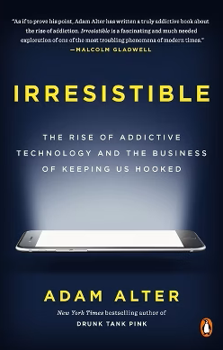
Smartphones
Why are students on university campuses (walking across the quad, eating in cafeteria, etc.) on their phone all the time?
A smartphone allows for the accelerated exchange of information
… the production and consumption of information as stimuli
The essence of information: surprise and stimulus it provides

Slide 24
The Limits
This assumption: More information the better. (derived from big data proponents)
What we need to nurture is “lingering,” not “flickering between.”
Stanford University Project; it is a practice for journalists, for fact-checking. Information literacy is not fact-checking.
(or faults) with Lateral Reading Methods in Information Literacy Instruction
Notes:
Have to talk about : more information the better
Have to practice lingering, not flickering between more information, skimming through.

Slide 25
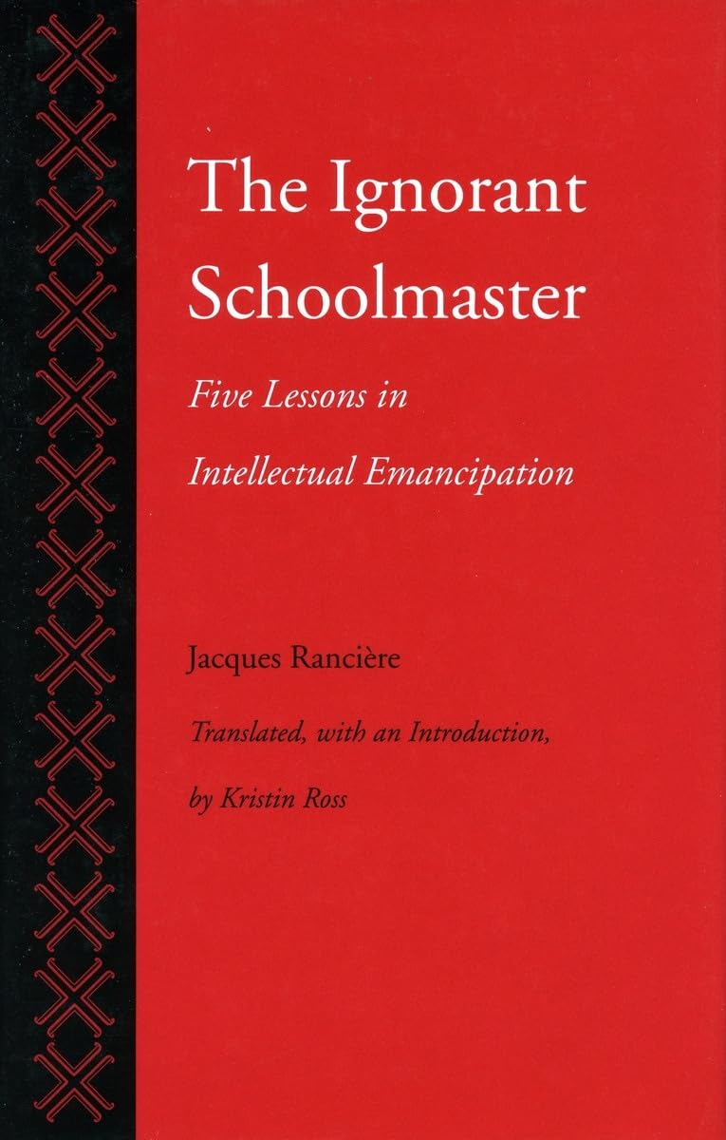
Info. Lit. Pedagogy..

Slide 26
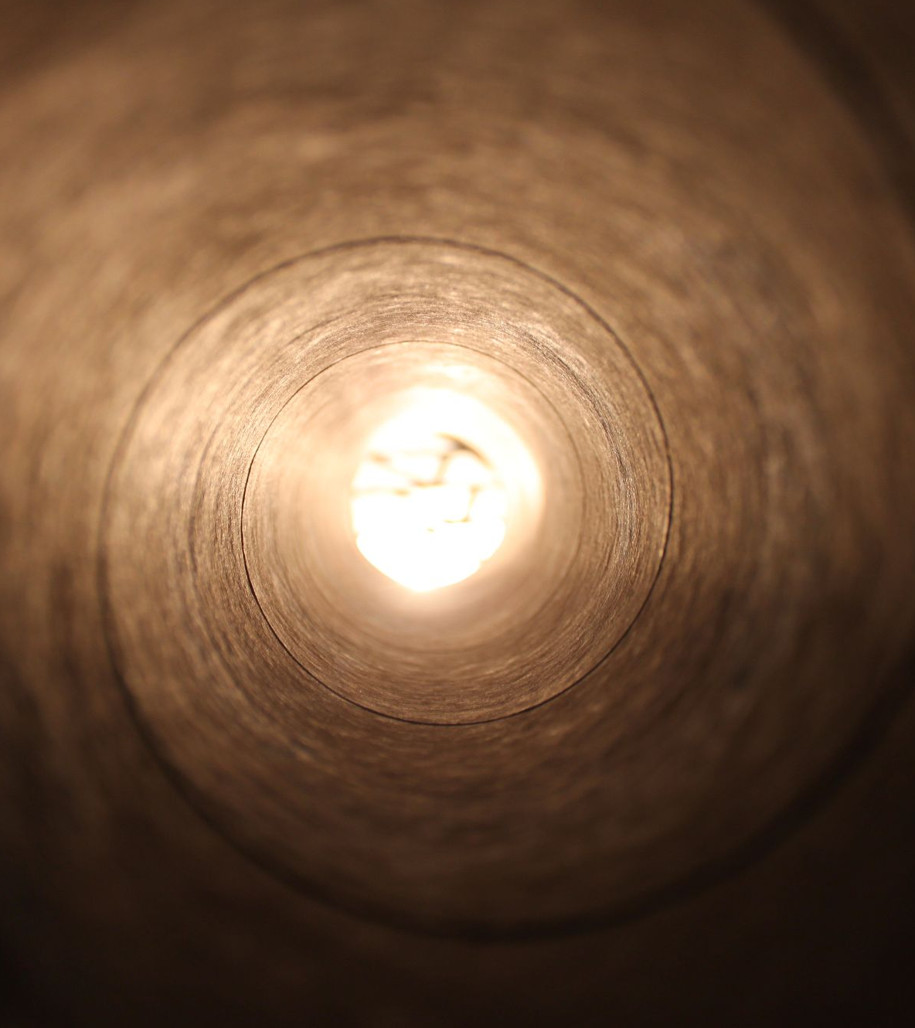


The experiments
Three possible activities
Notes:
Assessments…

Slide 27
After the library session, the students will be able to characterize “information” in the context of our hyper-digitalized 21st century in order to mindfully interact with information.

Slide 28
Information Literacy: To erase “contingency” aspect of information when we use it…

Slide 29
Activity #1
The sole purpose: to nurture awareness of how Information is used in the 21st century, and to mindfully interact with information
Academic database
Smartphone
Internet
Human interaction/experience
Defining “Information” together
Notes:
Starting the session this way (student-centered, sharing with classmates, and expanding the conceptual understanding of their prior knowledge) is a promising way to garner their attention and trust.

Slide 30
Discussing “information” with Students
Share two definitions mentioned in this presentation
Information as something that connects to form a new reality (or new knowledge)
Information as a stimulant (consumer society/corporate culture imperative)
Ask them to reflect on their own experiences with information. From which medium do they receive most of their information? (smartphone, computer, book, human-interaction). Does the medium matter?
Emphasize their own stake in this issue. What might be the consequences of a constant neural connection?
Make segway into reliable sources for their paper. How might these information differ from ones they receive from their smartphone apps?
In addition, intentional search vs. algorithmic pull can be discussed.

Slide 31
Activity #2
Narrative Worksheet
How information and narrative are different
https://docs.google.com/document/d/1Xidt6KnJ4vIGkb5XqC4d-FFNINpPPr3hPV_ZwG6vKkw/edit?usp=sharing
Creating a Narrative (not just gathering set of information as scattered dots)
Notes:
Point: saving information from scattered dot characteristics
Annotated bibliography

Slide 32
Information vs. Narration
Information
Information intensifies the experience of contingency
Information is additive and cumulative
It has no sense of direction
Information dissects time into a mere sequence of present moments
Narration
Narration reduces contingency by turning the accidental into necessity
Narration is a concluding form, creates a closed order that founds meaning
A narration carries “sense.”
A narrative brings forth a temporary continuum.
Notes:
In the context of a student’s paper

Slide 33
Activity #3
Looking beyond information vs. misinformation (true vs. false).
What might cause certain (mis)information to exist?
Group identity?
Justification of one’s belief?
Belief as a badge
Against certain institutions
Other ulterior motives?
Socially Strategic Expressions: Who is behind the information and why?

Slide 34
Group Activity (link provided)
Group 1: 911 Truthers
Focus on: “The administration does consider the lives of American citizens to be expendable on behalf of certain interests.”
Group 2: Mike Hughes Rocker daredevil
Focus on: “Still, Hughes converted to the flat-Earth belief recently, shortly after his first fundraising campaign for the rocket earned just $310 of its $150,000 goal. His second campaign, this time posted after his conversion and with the support of the flat-Earth community, succeeded in hitting its $7,875 goal.”
Group 3: Catholic Eucharist
Focus on: “The transformed bread and wine are truly the Body and Blood of Christ and are not merely symbols. When Christ said “This is my body” and “This is my blood,” the bread and wine are transubstantiated. Though the bread and wine appear the same to our human faculties, they are actually the real body and blood of Jesus.”
Group 4: Anti-Union
Focus on: On creator of the organization.

Slide 35

Q & A
Please feel free to email me with any questions or collaboration interest!
Notes:
The library, an institution indispensable to the functioning of democracy, has a vital role to play in this era of unrest.

