Slide 1
CORA:
An Open Access Community for Faculty and Librarians
Susan Gardner Archambault
Loyola Marymount University
susan.archambault@lmu.edu

Slide 2
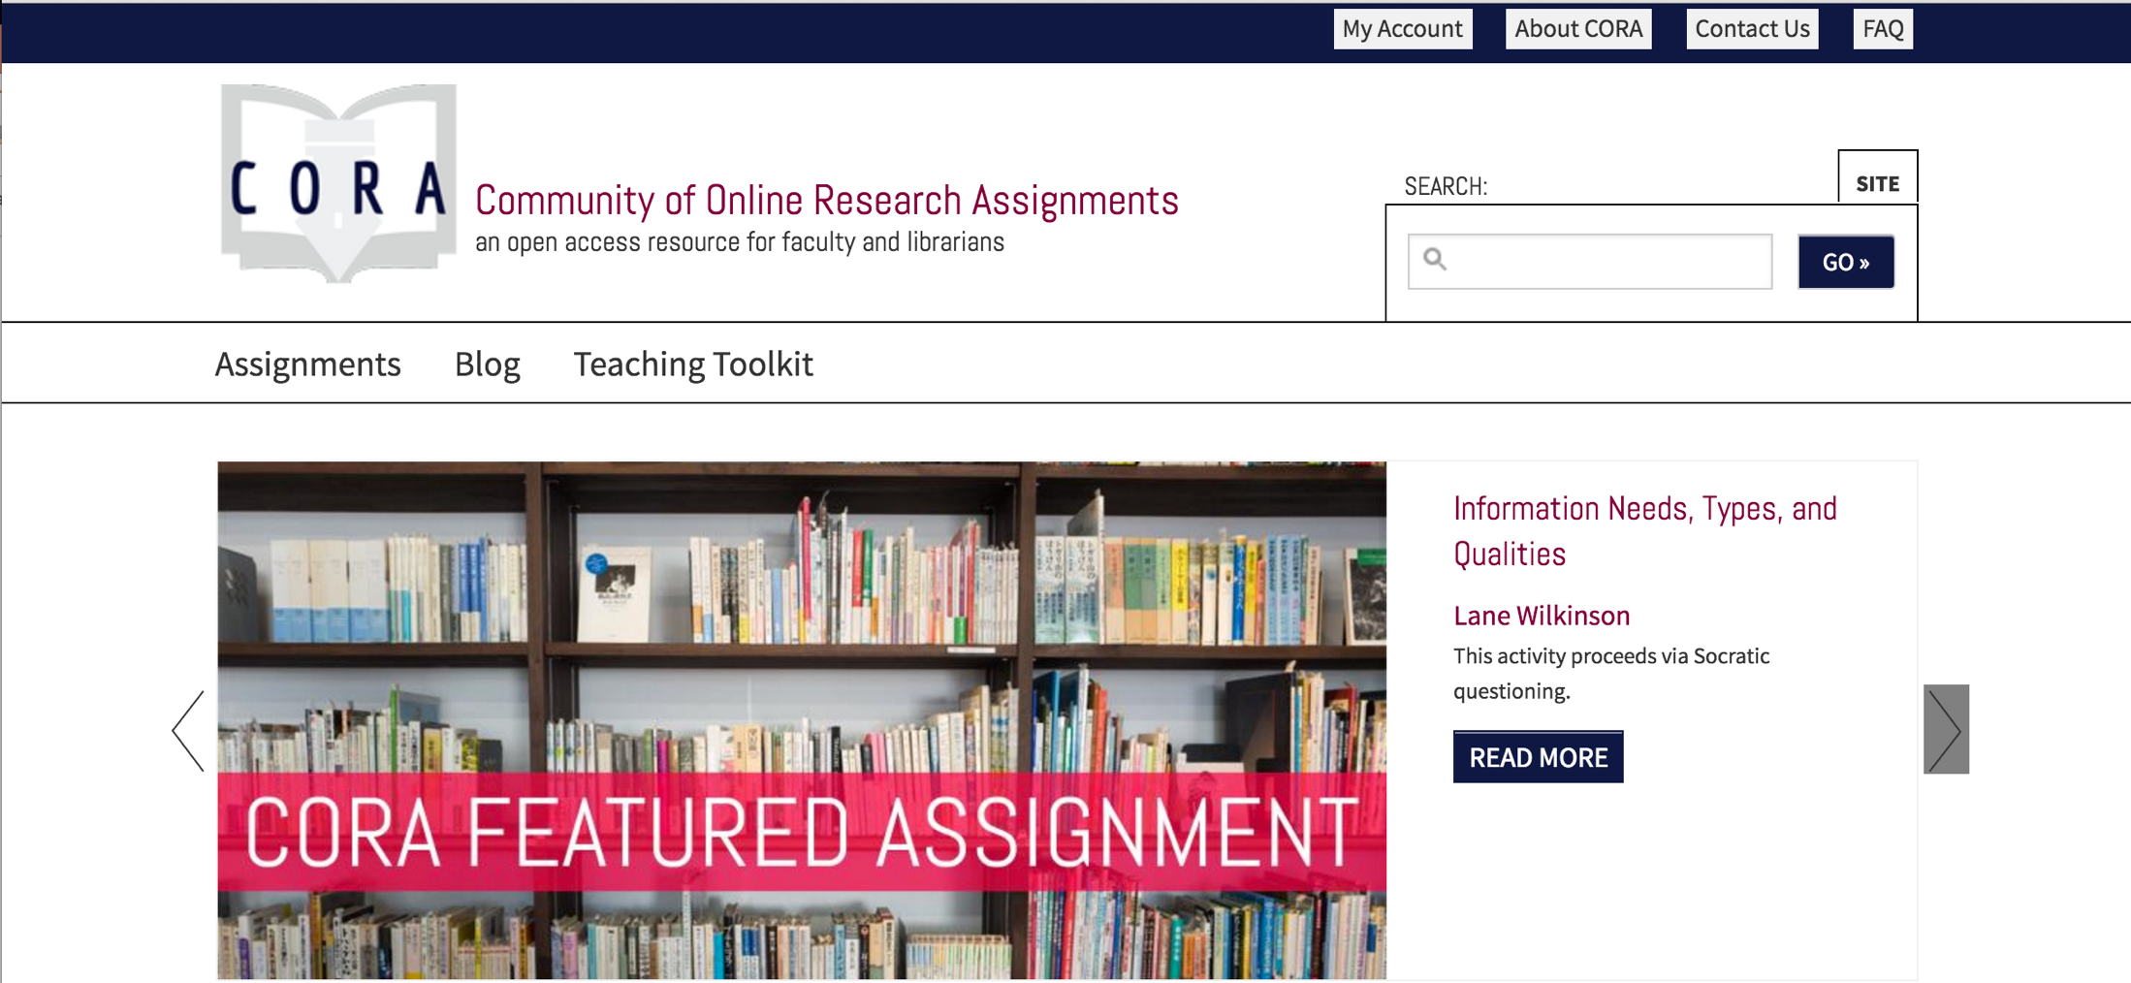
What Is CORA?
www.projectcora.org

Slide 3
Project Funding
Image courtesy of http://scelc.org/about

Slide 4
Recipe Metaphor
Image courtesy of http://tastykitchen.com
Image courtesy of http://railhighered.org

Slide 5
Tell us about a research assignment that you think was effective or productive? What made it so?
Did you ever assign a research assignment that wasn’t effective or productive? Why didn’t it work?
What features would make a shared online research assignment database easier for you to use?
How do you come up with ideas for research assignments?
Do you like the name CORA for this project?

Slide 6
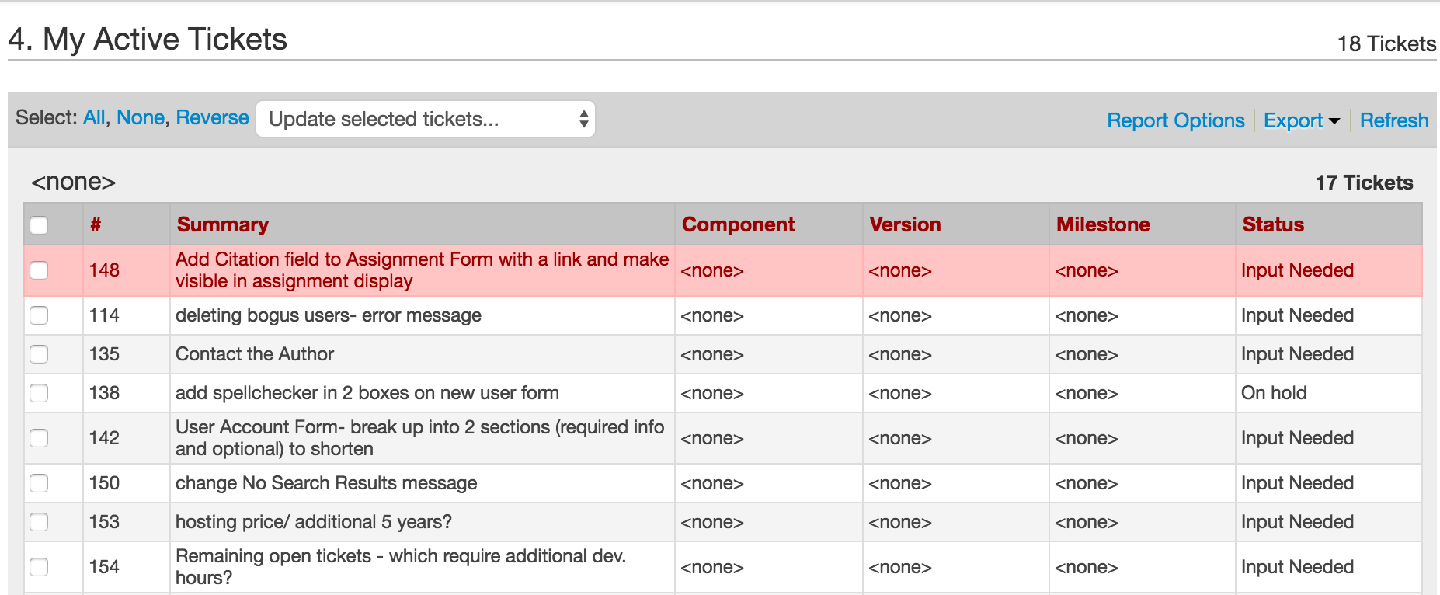
Project Development

Slide 7
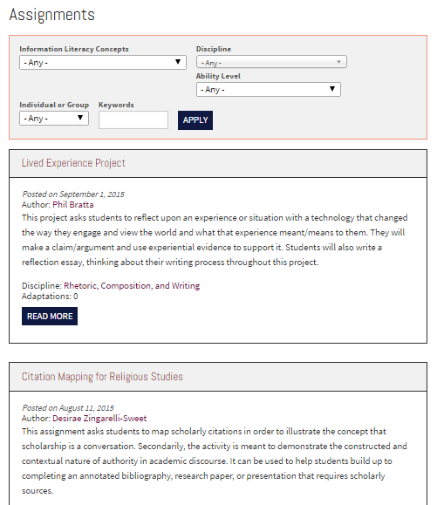
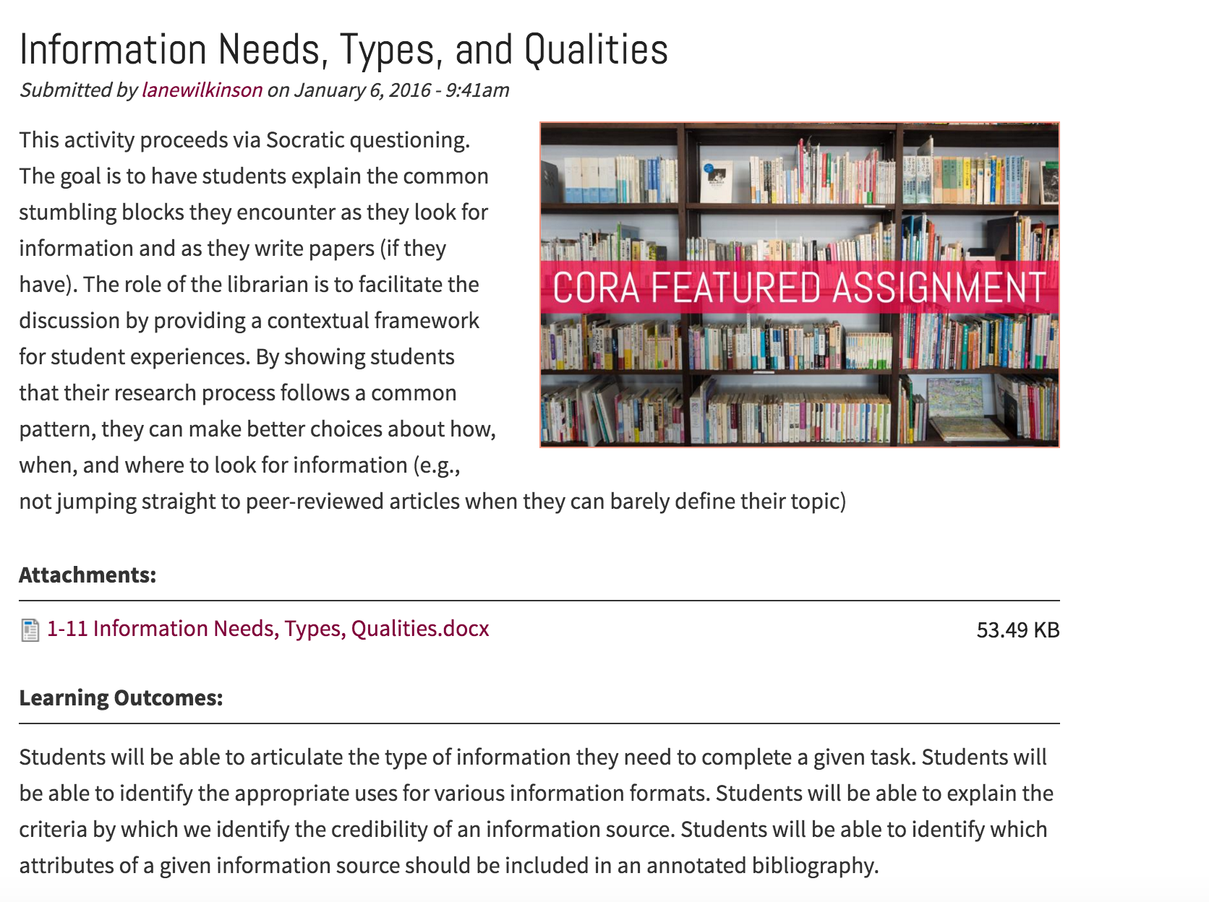
Assignment Search
Assignments
Assignment Example

Slide 8
Open Educational Resource (OER)

Slide 9
Search Teaching Resources
Teaching Resources
Teaching Resource Example

Slide 10
UX: Ongoing Questions
How well are users able to find the results they need when searching for materials on the CORA site? How can their success be improved?
What is the information-seeking behavior of instruction librarians as they design research assignments? Which online resources do they use?
How can the ease of use be improved for CORA contributors?
How can CORA be useful for an international audience beyond the United States?

Slide 11
Overlap: Information Literacy Standards in US, UK, & AU/NZ
 | Identify Info Need | Find Info | Evaluate Info | Use Info | Ethics
ACRL Standards (US 2001) | ACRL 1 (Defines info need) | ACRL 2 (Accesses info) | ACRL 3 (Evaluates info critically) | ACRL 4 (Uses info effectively) | ACRL 5 (Uses info ethically & legally)
ACRL Framework (US 2015) | Research as inquiry | Searching as strategic exploration | Authority is constructed /contextual; Scholarship as conversation | Information creation as a process | Information has value
ANCIL (UK 2011) | X | Strand 5 (Resource discovery) | Strand 4 (Mapping and evaluating) | Strand 8 (Present and communicate) + Strand 9 (Synthesizing) | Strand 7 (Ethical dimension)
ANZIL (AU/NZ 2004) | ANZIL 1 (Recognizes) | ANZIL 2 (Finds) + ANZIL 4 (Manages) | ANZIL 3 (Critically evaluates) | ANZIL 5 (Applies) | ANZIL 6 (Uses)
SCONUL (UK 2011) | SCONUL 1 (Identify) + SCONUL 2 (Scope) | SCONUL 3 (Plan) + SCONUL 4 (Gather) | SCONUL 5 (Evaluate) | SCONUL 7 (Present) | SCONUL 6 (Manage)

Slide 12
Revised Assignment Search Filters

Slide 13
Search Functionality
Search results incomplete
Inconsistent tagging

Slide 14
Enhance Community Features

Slide 15
www.projectcora.org
Instruction Section Innovation Award 2017
@projectcora
facebook.com/openprojectcora

