Slide 1
OER Workshops for Faculty: Distance Learning & Library Collaborations

Slide 2
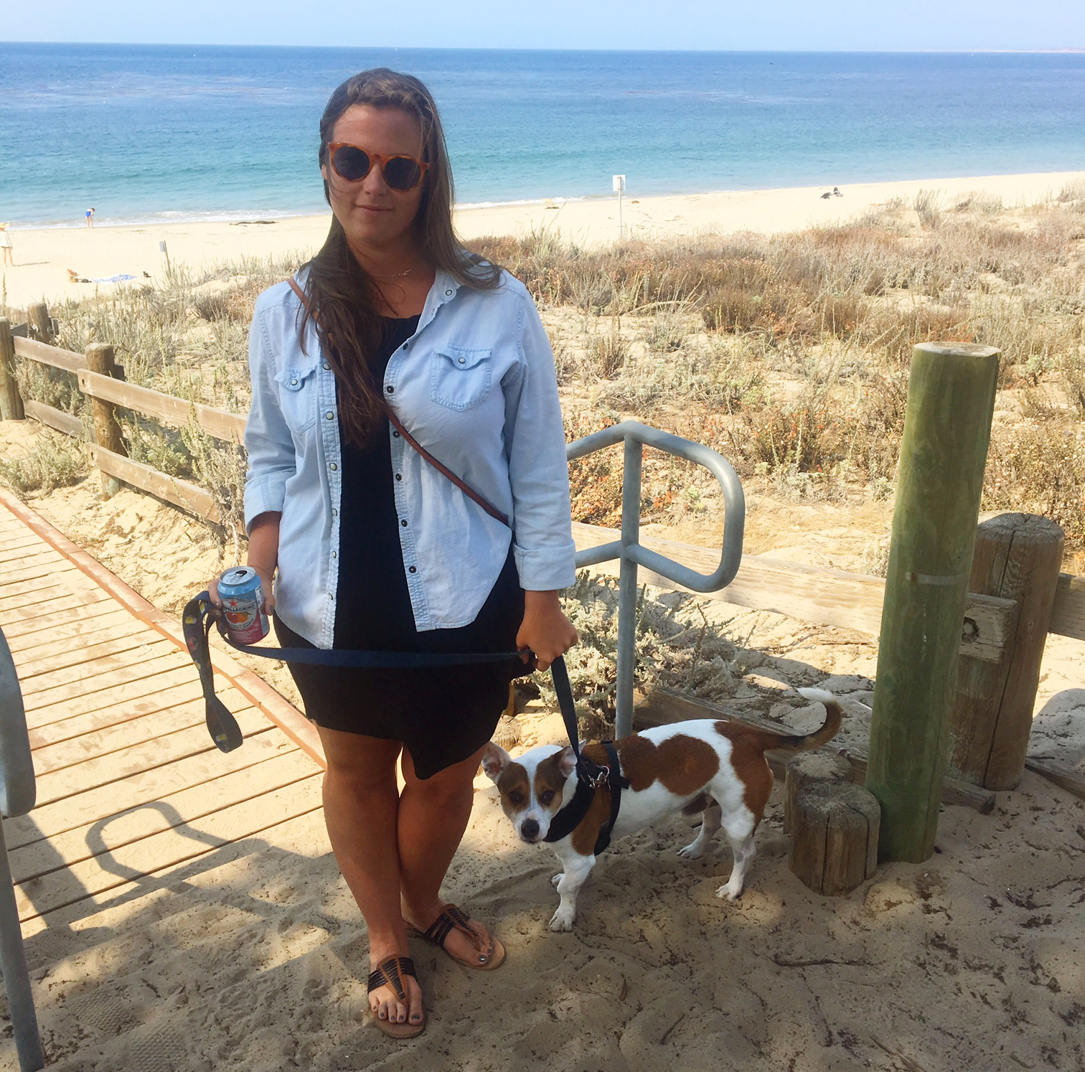
HELLO!
I’m Lindsey Wharton,
Extended Campus and Distance Services Librarian at
Florida State University.
lwharton@fsu.edu
@lnwharton

Slide 3
Why distance learning & OER?

Slide 4
Our OER Team & Initatives
A Multi-Pronged Approach

Slide 5
Our Initatives
Alt-Textbook Grant Program
Textbook Broke campaign
Student survey
OER LibGuide
OER in eReserves
OER faculty outreach

Slide 6
Office of Distance Learning Faculty Development Series

Slide 7
“Innovate your Course with Open Educational Resources”
Benefits of OER
Finding OER
Creating OER
OER Support at FSU
Copyright

Slide 8
Why it worked
right time for instructors
campus-wide promotion
online access issues

Slide 9
OER in the LMS

Slide 10
Leverage partnerhsips. Collaborate. Unite expertise.
Scholarly communication, distance services, distance or distributed learning.

Slide 11
THANKS!
Any questions?
You can find me at
@lnwharton · lwharton@fsu.edu

