Slide 1
Taking a Byte out of Information Illiteracy: How FIDM’s Google Bytes: Scholar and News Introduces Students to Open Education Resources
By Carly Lamphere
Head of Adult Reference, Crowell Public Library

Slide 2
Summer 2015 at FIDM….
Library Instructional Presentations
Reference Services
Quality of Student work/research
More information literacy, database use, and less Google?
Enter Google Bytes!

Slide 3
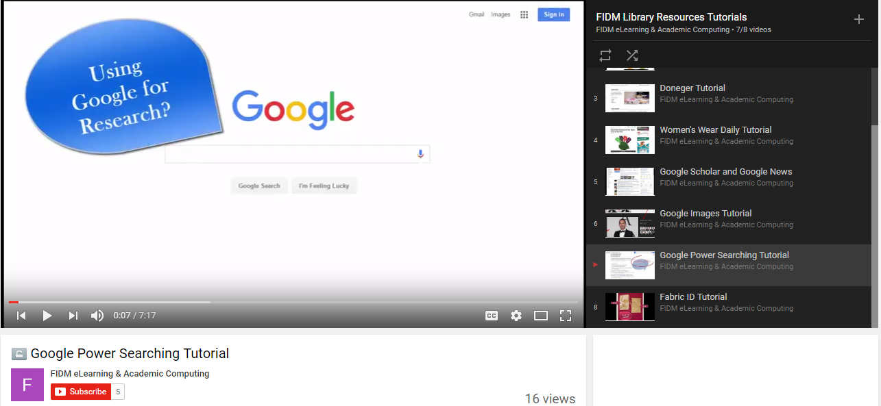
Google Bytes
Above: Supplementary handout for ‘Google Bytes: Images’ Tutorial. Below: Still from the ‘Google Bytes: Power Searching’ Video Tutorial.
Brief Workshops focusing on small practices when using Google
Images, Search filters operators, Google News and Scholar
Introduce/ promote library databases in process.
Help students become comfortable with research and improve their assignments/projects.

Slide 4
Trials, Tribulations, and Ultimately Success
Initially under attended
Collaboration/Outreach with Faculty
Video Tutorials
Supplementary Materials
Branching out of topics

Slide 5
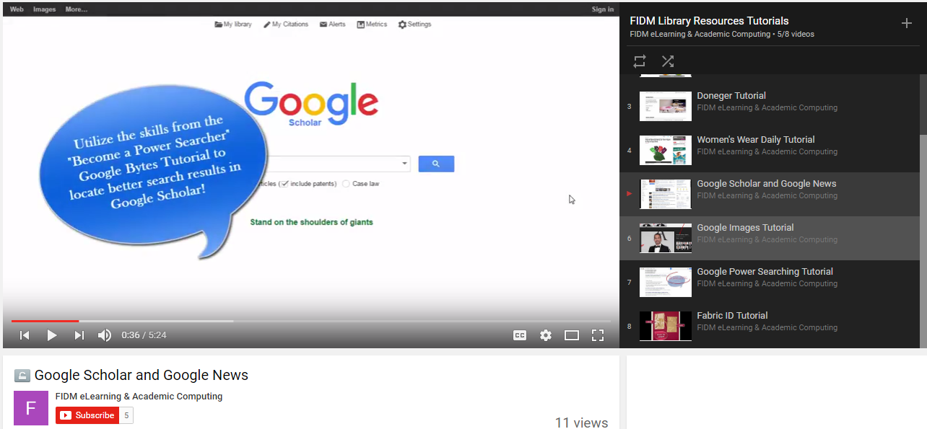
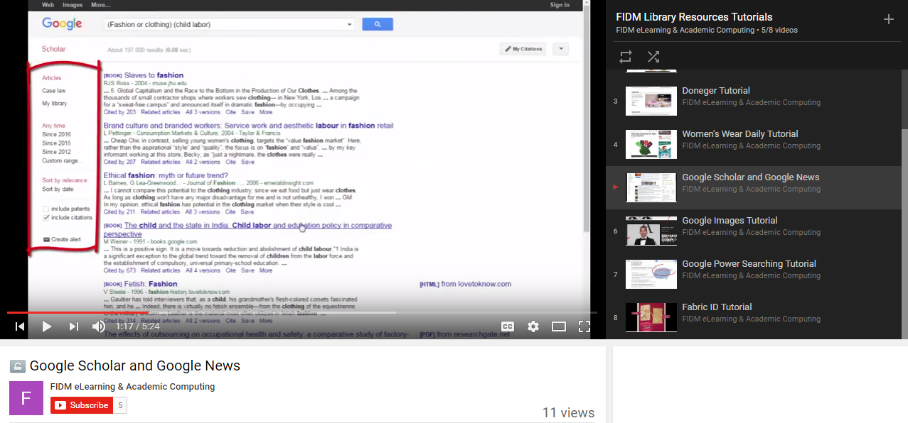
Google Scholar and News Workshop
Google News
Filters and search terms
Google Scholar
Filters and search operators
Full text search-access
Importance of evaluation of information/peer evaluated articles
Value of Open Access Educational Resources vs. web articles
Right: Stills from the ‘Google Bytes: Scholar and News’ Workshop

Slide 6
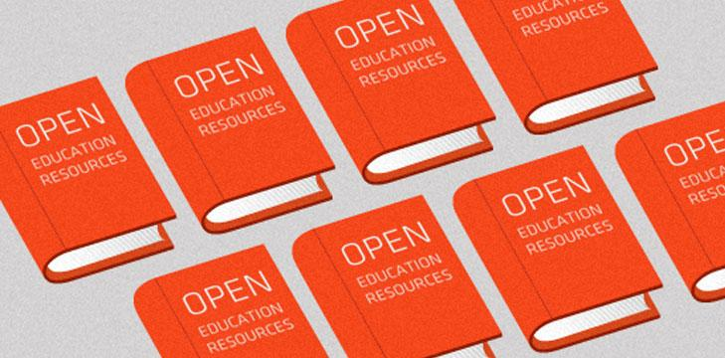
Benefits of Open Access Resource Use
Benefits of Open Access Resource Use
Less “intimidating”/Introduction to Library Database Use
Art students utilize a variety of sources for projects
Enforces the “Scholarship as Conversation” Standard ACRL Framework
Realistic, lifelong scholarship, information literacy skills.

Slide 7
Thank You!
Carly Lamphere
Crowell Public Librarian
clamphere@cityofsanmarino.org
(626) 300-0777 Ext 542

Slide 8
References
Brophy, Jan and Bawden, David. “Is Google enough? Comparison of an Internet Search Engine with Academic Library Resources”. Department of Information Science City University, August 2005. Accessed April 2017.
Georgas, Helen. “Google Vs. the Library: Student Preferences and Perceptions When Doing Research Using Google and a Federated Search Tool” portal: Libraries and the Academy 13, 2 (2013): 165-185.
Butcher, Neil. “A Basic Guide to Open Educational Resources (OER)”, Commonwealth of Learning, 2011, 2015
Images:
https://www.jisc.ac.uk/blog/sharing-the-love-for-oer-and-you-should-too-09-may-2014

