Slide 1
Integrating within the LMS: A New Lens for Library Guides
Oscar Giurcovich, Research and Instruction Librarian, Nevada State College
Francesca Marineo, Instructional Design Librarian, Nevada State College
Notes:
Good afternoon, everyone! I’m Oscar Giurcovich, and I’m a research and instruction librarian at Nevada State College. Joining me is my instruction partner in crime Francesca Marineo, instructional design librarian.

Slide 2
Agenda
Background
How NSC Created Library Guides in the LMS Platform
Lessons Learned and Recommendations
The Future
Questions
Tagxedo.com
Notes:
Today we’re going to share a project in which we created library guides within an LMS. First, I’m going to talk a bit about the college itself and about what we had been doing in the library before the project. Next, we will take you through the mechanics of how our Library Guides work and look at them more in-depth. We will also share our lessons learned on the experience so far and some recommendations on how this can be done at other institutions. Finally, Francesca will talk about our future plans before we take your questions!

Slide 3
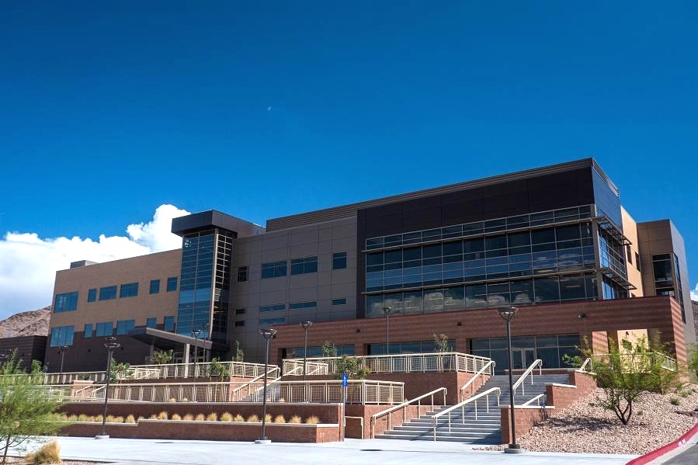
All About Nevada State College
Opened in 2002, 177 students enrolled
Spring 2016 enrollment: 3,500+
Two new buildings in 2015
Marydean Martin Library is the first digital library in the state
1.4 million ebooks!
Highly diverse commuter campus
Notes:
Before we dive into our project, I’d like to give you some background and context of our environment. Nevada State College is located in suburban Henderson, NV about 15 miles from Las Vegas. NSC opened in 2002 with 177 students and has since grown to about 3,500 students. We are an entirely commuter campus as we’re without residence halls, and many students attend part-time or completely online. With respect to our teaching staff, we have a large number of part-time instructors at NSC, many of whom teach solely online and are not able to visit campus at all.
The Marydean Martin Library reopened in the fall of 2015 within the brand new Rogers Student Center, which you see here, one of two brand new buildings.

Slide 4
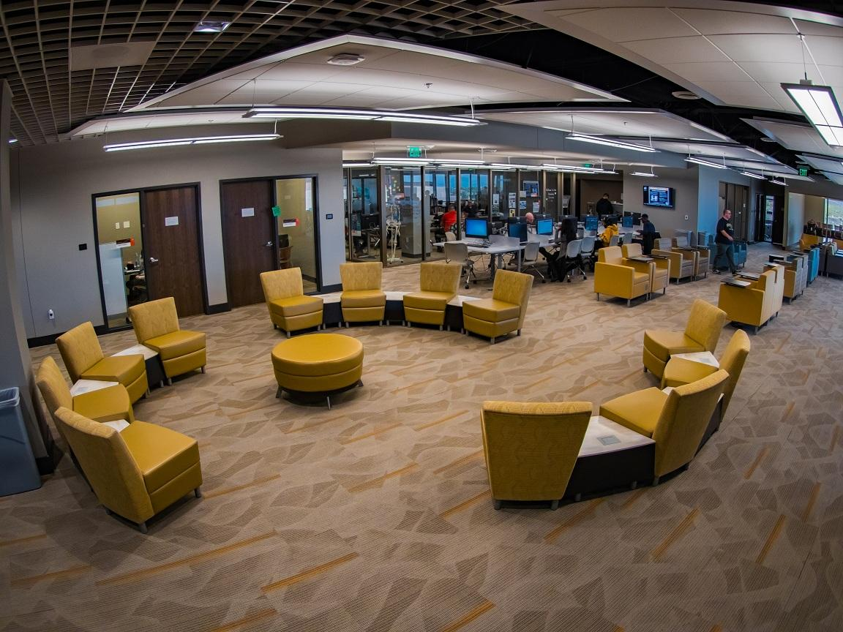
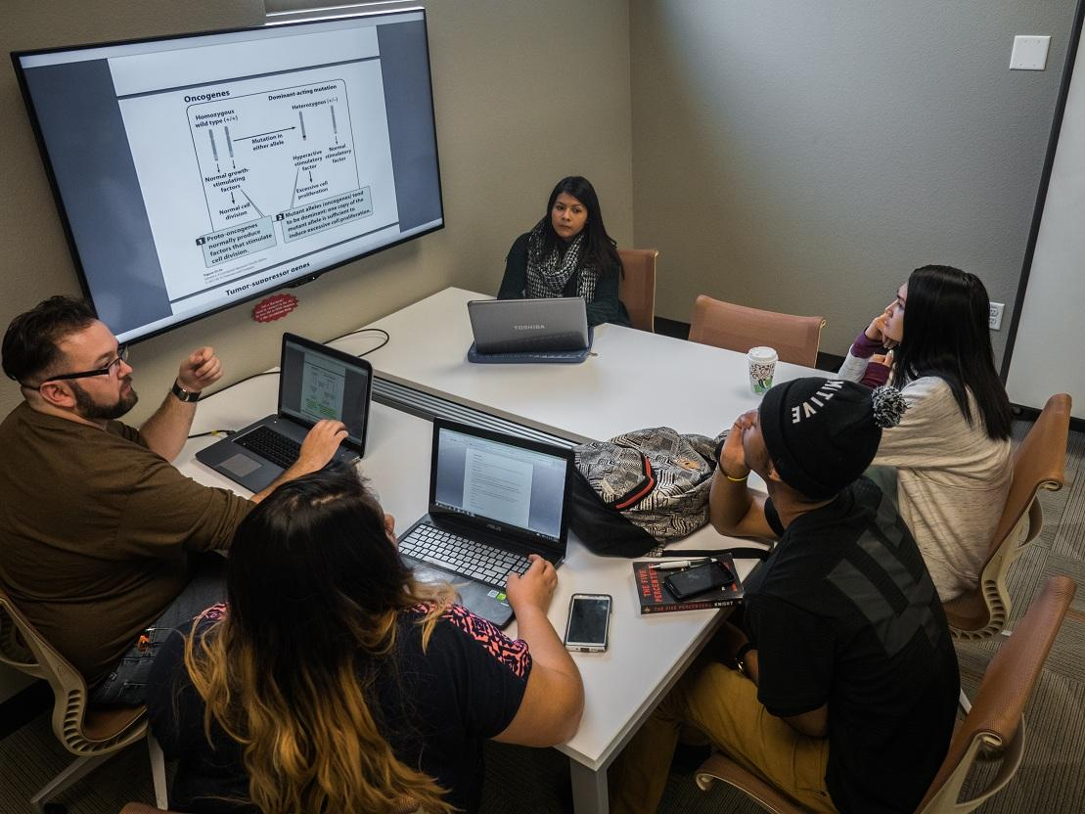
Marydean Martin Library
Notes:
As the first digital library in the state, we have made efforts to acclimate students and faculty to library services in a primarily online format, with our physical space dedicated to providing a technology-rich learning environment with 1.4 million ebooks instantly available online. Given this shift in platform, it was also apparent we needed to evaluate the current state of our learning objects already in place to see what needed to be brought up to date or reinvented entirely.

Slide 5
Canvas@NSC
NSC Presence
Faculty required to use it to some degree
Used by most other institutions in Nevada
NSC Library Presence
Discipline and course-specific modules
Canvas Commons Repository
Notes:
At Nevada State College, we use Instructure’s Canvas platform as our learning management system. Currently, most of the other public institutions in the state have also migrated to Canvas. All faculty are required to use the LMS for their courses in some way; some instructors teach hybrid classes that meet in person a few times with the remainder of instruction online, while others use it to track students’ progress only.
Considering all of this, and in order to best serve our student population, we decided to create a series of discipline and course-specific research guides within our LMS, Canvas. Designed as course modules, which are usually used to organize a week of class content, we are now able to provide library instruction and resources directly at our students’ point of need. Before we go into more detail about what these guides actually look like and how they function, I’d like to talk a little bit about what we were doing before and what brought us to integrating our Library Guides within the LMS.
On that note, we were wondering, is anyone here currently using the LMS Canvas? Ok, great. Well, no matter which LMS you use, we hope that this presentation will provide some background and inspiration for doing similar initiatives at your institution.

Slide 6
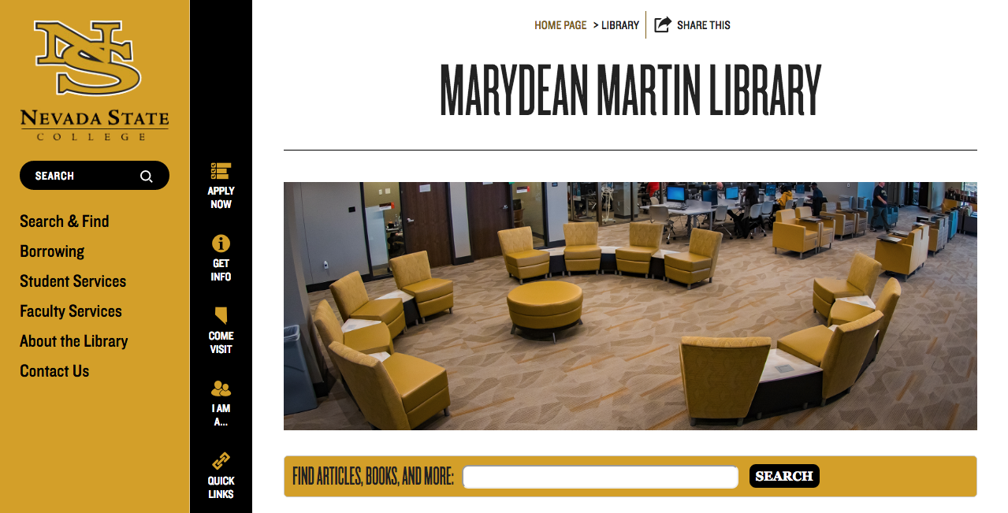
Before Library Guides in Canvas - Presence
LibGuides
Consisted of a few course and subject guides
Video tutorials
Online Library Orientation
Library website
Not customizable
NSC Library Online (Canvas)
Service focused
Notes:
Now, I am sure that many of you are very familiar with the content management system LibGuides, which is used almost ubiquitously across academic libraries. We too had a series of LibGuides for a few subject areas and courses. However, the content was severely outdated. Also, we had other library learning objects such as video tutorials and an online library orientation for some academic programs, which were available on YouTube.
This is all in addition to, of course, our Library Website. Until the summer of 2015, we had very little control over the content and look of our website. As a result, our library had tried a few solutions to providing tailored content, including hosting an external website and developing a public course called NSC Library Online in the LMS that could serve to provide links to library resources and service within Canvas. Needless to say, we had a lot of information in many different places.
In the summer of 2015, with increased permissions to update our institutionally hosted website, we consolidated all our content back to nsc.edu/library and deleted redundant information from our NSC Library Online course. This gave us a blank canvas (pun intended :P) upon which we could build our presence within the LMS.

Slide 7
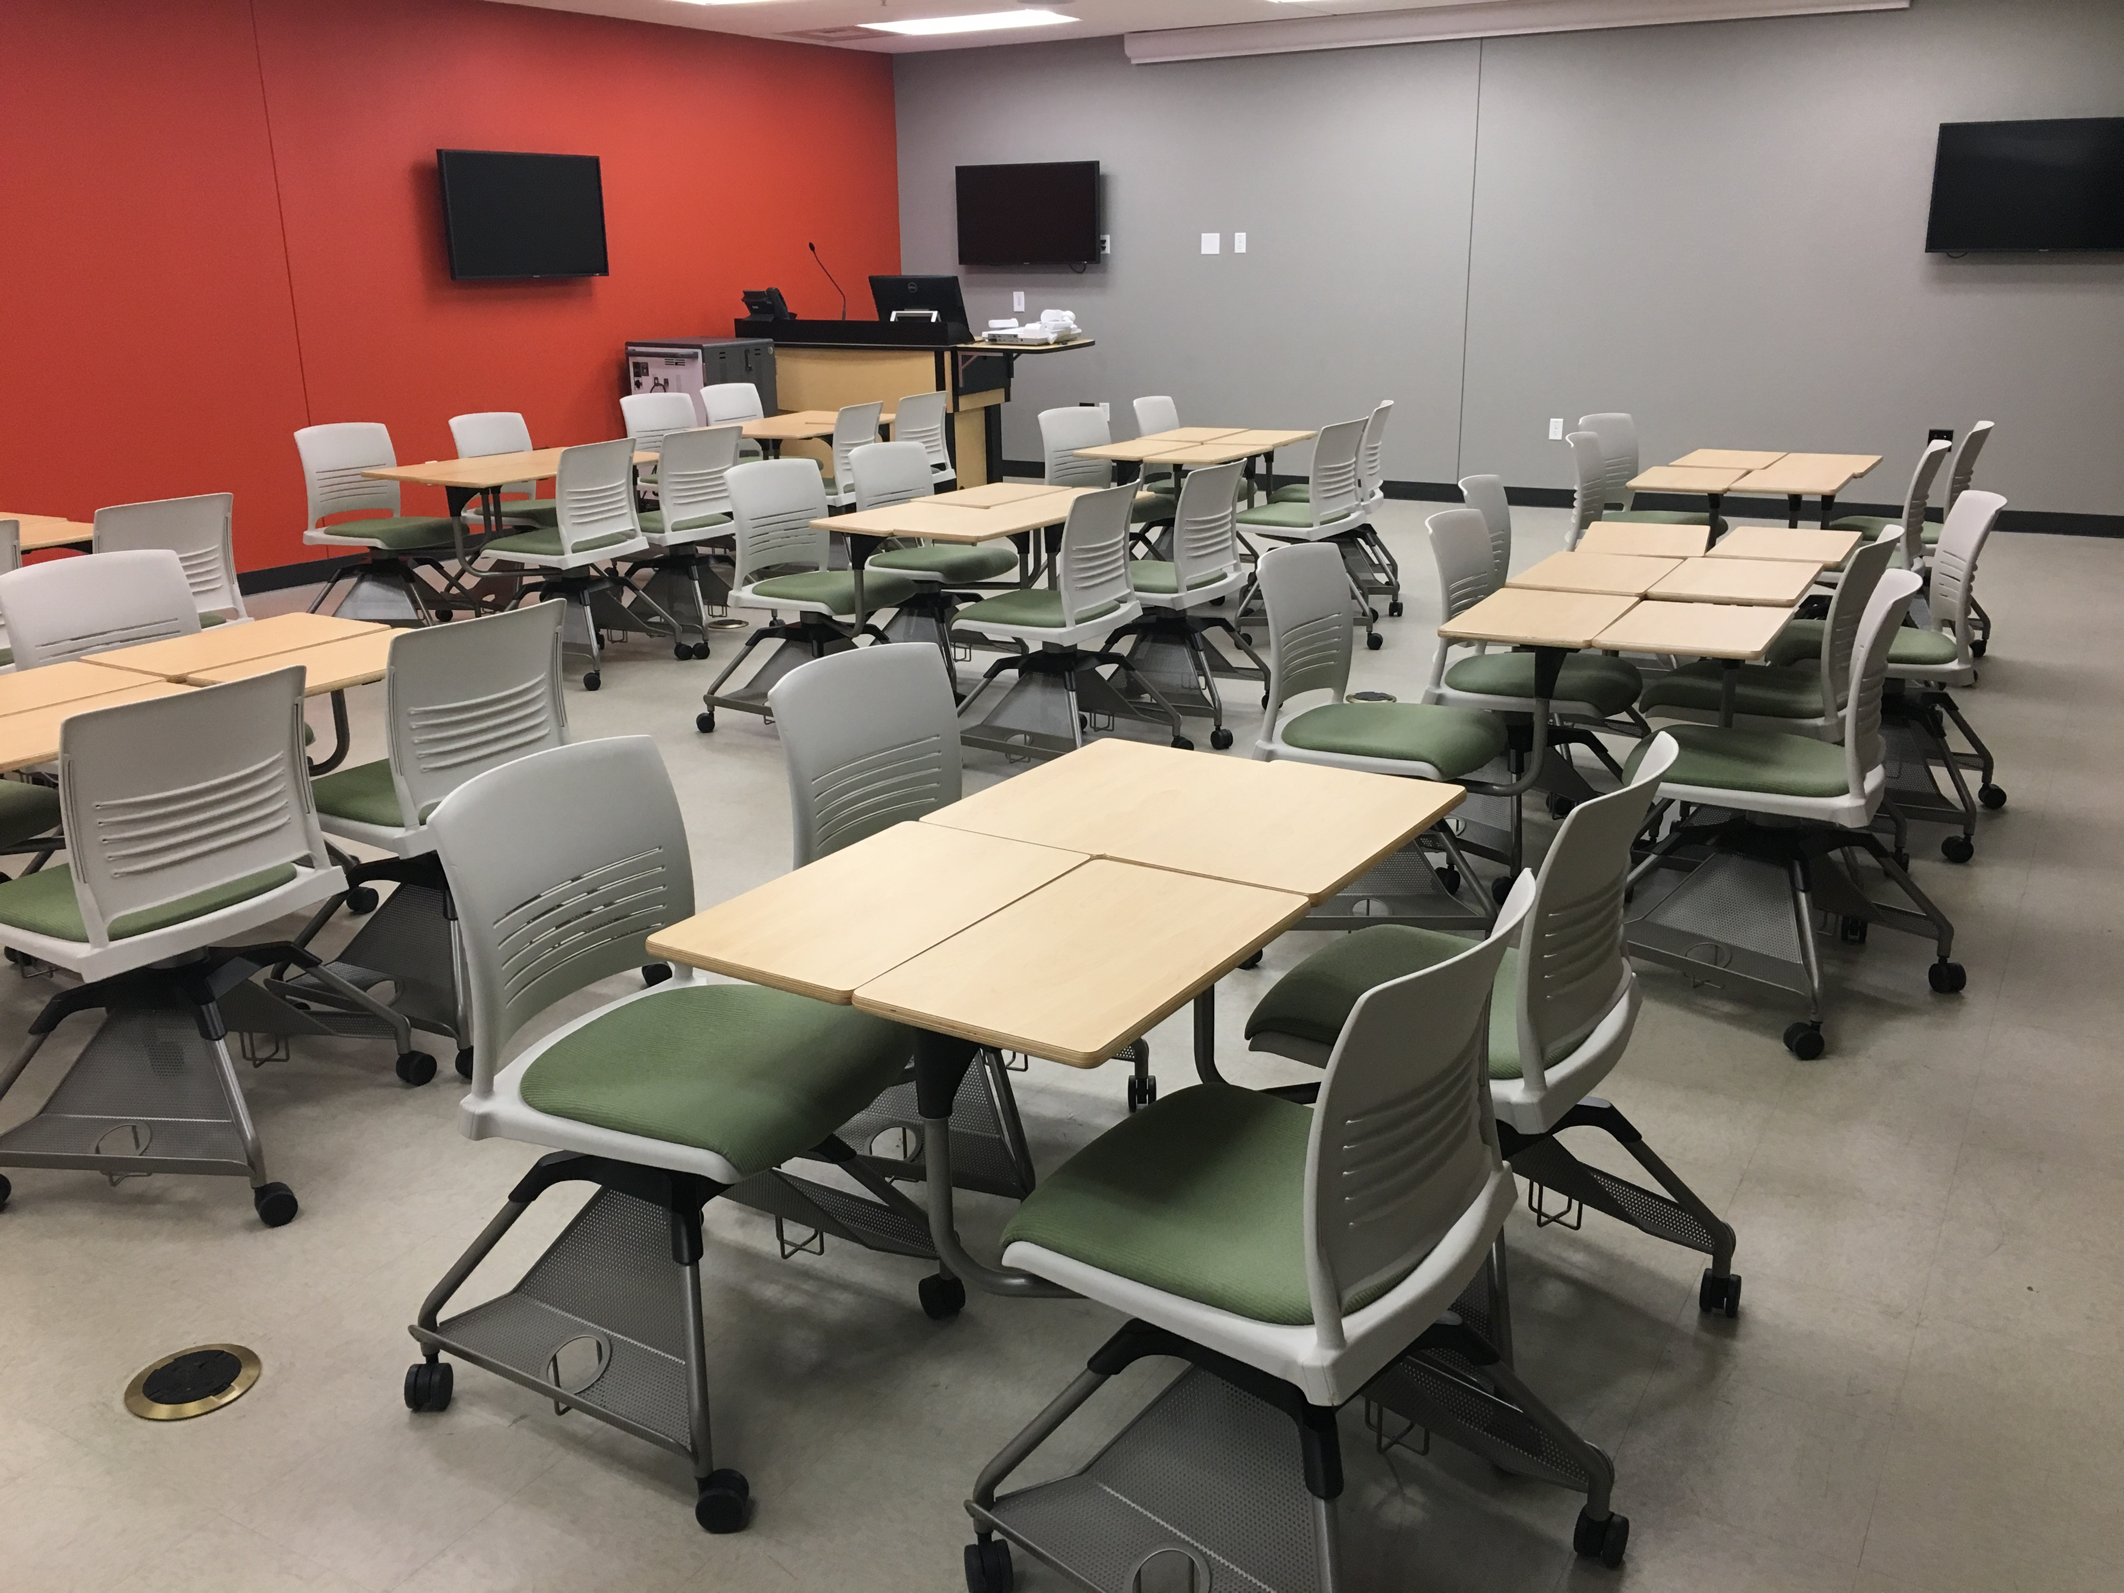
Before Library Guides in Canvas - Instruction
One-shot sessions in library classroom
Handouts
Staffing concerns
2 instruction librarians
Classes with required research component
Notes:
In regards to information literacy instruction, we have traditionally provided one-shot live instruction sessions utilizing handouts and other low-tech learning objects as necessary. With the opening of the new building, we also opened our first library instruction room called the Innovation Commons, pictured here. It is equipped with highly modular furniture and a laptop cart for up to 40 students. Unfortunately, although our physical space grew and our student population with it, our staff size remained the same. This was the perfect opportunity for us to move to a more scalable approach to information literacy instruction.

Slide 8
Why Library Guides in Canvas?
Establish LMS presence
Full integration into course
Increase relevance of library content at point of need, just in time
Assessment!
LibGuides
Limited collection of pre-existing guides for LTI
Sustainability
CEP 123 Course Pilot
Required course
Notes:
With a high demand for instruction and the need to move to more sustainable initiatives, we were inspired to move into Canvas. One course in particular demonstrates why this innovation in the LMS was not only necessary, but also effective.
Each semester we are asked to provide in-person, one-shot instruction sessions for a Counseling and Educational Psychology (CEP) 123 course, College and Career Success. CEP 123 is a two-credit first-year experience course required for all entering students and transfer students with less than 30 transferable credits in which students must complete a research assignment that incorporates scholarly, peer-reviewed library resources. With only two instruction librarians and other requests and responsibilities to attend to, we considered alternatives to the one-shot instruction model, and thus Library Guides in Canvas were born.
Just out of curiosity: By a raise of hands, how many of you have in one form or another integrated library resources or services into your institution’s learning management system?
Well, you may be wondering, why, if we already had LibGuides, we changed to Library Guides in Canvas. For us, it just made sense. LibApps has introduced a LTI in the last year or so that can be integrated into any compliant LMS, and this may be something useful for many of you who have a robust collection of LibGuides. LTI stands for learning tools interoperability, which allows applications, in this case LibApps, to be fully integrated into a compatible program such as a LMS. In our case, we had very few guides and saw this as an opportunity not only to create new course or discipline-specific content, but to truly establish ourselves as an integral component of the LMS. As you will see, the Library Guides are designed to integrate fully into the course shell. This is significant for a few reasons.
First, the library instruction is given a new context in relationship to the course material that surrounds it, making it more pertinent to the students. Second, the ability to add assessments, such as assignments and quizzes within the module, provides new avenues for assessing and evaluating our impact. Finally, being integrated within the LMS allows us, in the words of John J. Burke and Beth E. Tumbleson, to “impact students at the moments of greatest need for research assistance.” (pg. 7) Their report, Learning Management Systems: Tools for Embedded Librarianship published this year is one of many publications that discusses the positive impact that this sort of integration can have on student outcomes. We’ve included some references at the end of our presentation if you are interested in looking at additional work on this topic.
Aside from bringing the content directly to the students’ point of need, integrating within the LMS also helps to provide more scalable and sustainable instruction, alleviating the demand on the librarian. There is a lot of literature which looks at how academic libraries can move away from the traditional one-shot to incorporate more sustainable instruction into the curriculum. This can be a huge undertaking, but starting small, like we did with our CEP program, has allowed us to pilot our Library Guides in a relatively small portion of classes at our college that are also very high-impact, since virtually all students are required to take this course.
So, in considering the needs of our CEP course and our student population, an instructional module within Canvas was a natural innovation for us. Moreover, the added benefit of increased assessment and access to LMS data meant we could also conduct more meaningful assessment of our interventions and in return make data-driven decisions in support of student success.
With that said, I’m going to turn it over to Francesca who will talk in more detail about the CEP Library Guide.

Slide 9
Design and Implementation of the CEP Library Guide
Notes:
Hi, again my name is Francesca Marineo and I am the Instructional Design Librarian at Nevada State College. First I’m going to talk a bit about the process that led to us creating our library guides, then show you some visuals of the module, before finally sharing some of the assessment data from this project. Before I begin, however, I wanted to say that although we use Canvas and decided to create our guides directly within the LMS, this is something that you can adapt at your institution, no matter what content or learning management systems you use.

Slide 10
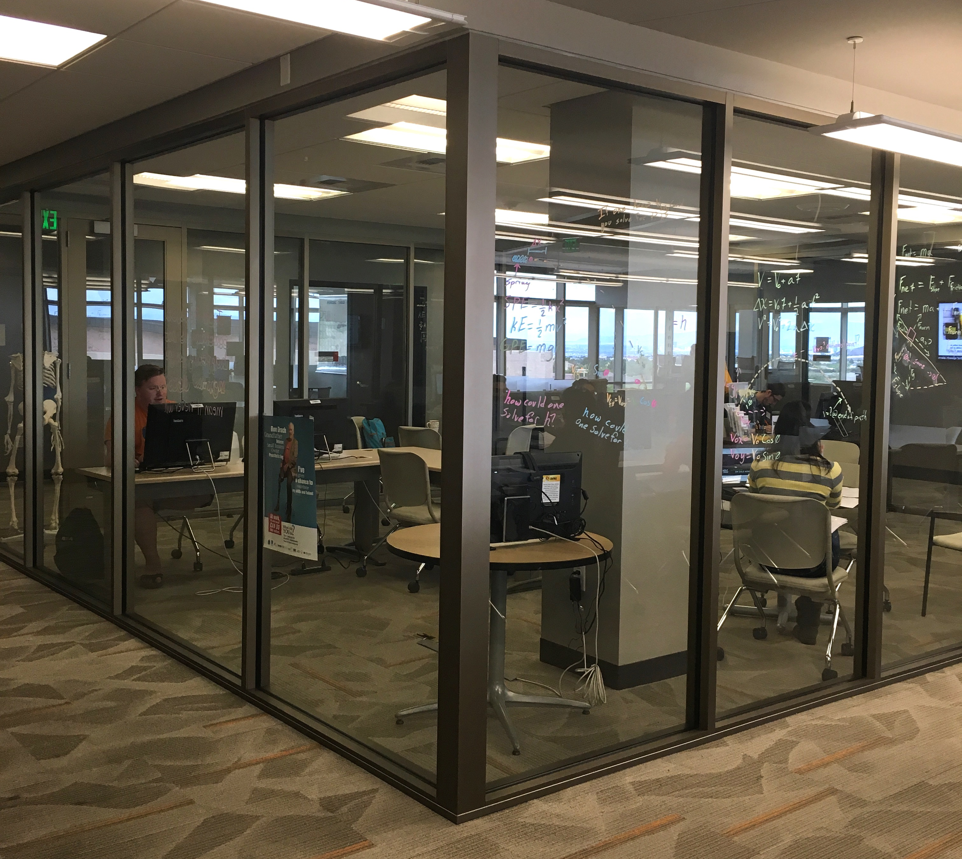
Step 1. Collaborate: Director of the CEP Program
Notes:
Now, I want to really emphasize the first step in this process, which I am sure you will all agree with, and that is collaboration. Of course, this is often easier said than done. We are very lucky at Nevada State on our small campus to have strong relationships with many of our student support services, faculty members, and even administrators. Although it is a continually uphill battle, collaboration is imperative to not only creating content that is relevant and effective for our students, but also to get faculty buy-in.
Once we had decided to integrate within the LMS and design a course specific CEP Library Guide, the first thing I did before designing the module was meet with our Director of the Academic Success Center and CEP program. The Academic Success Center is located in the same space as the library, which you can see here. We discussed the expectations of the guide and the specific content that it should cover. Most importantly, we made sure it would address the information literacy and critical thinking learning outcomes for the course, as well as the assignment-specific outcomes. With her support and the course details in hand, I designed our first Library Guide.

Slide 11
Step 2. Design: module in sandbox course
Notes:
The CEP Library Guide is currently our only course-specific guide, and it is from this module that we decided to create all of our discipline-specific modules, as well. The Guide was designed in a library sandbox course created by our Office of Instructional Technology. This screen shot gives you an idea of what the designing process was like, however, I won’t go into the technical details, as depending on which LMS or CMS you use, these will differ. If anyone has any specific questions, though, about this part of the process, I would be happy to follow-up with you after the presentation.

Slide 12
Step 3. Share: Commons learning object repository
Notes:
Once completed in our sandbox course, the module was shared to Canvas Commons, a learning object repository offered through our LMS, where users can share and import content. The Library Guide was made available to all users at Nevada State College. This screen shot shows what an instructor would see when searching for a Library Guide within Canvas Commons. In a few simple steps, instructors can import content from Commons directly into their courses.

Slide 13
Step 4. Implement: Outreach to instructors
Notes:
Once instructors found the correct Library Guide in Commons, they select it and a bright green button with a drop down menu featuring the instructors courses will allow them to import the module directly into their course. I created a short handout with these steps that was then emailed to all CEP instructors by the CEP Director. I also followed up personally with all of the CEP instructors over the course of the semester, including a link to a survey to provide feedback about the guide. We will discuss some of this feedback later on.
Now, let’s take a look at how the guide actually supports students at their point of need within the LMS.

Slide 14
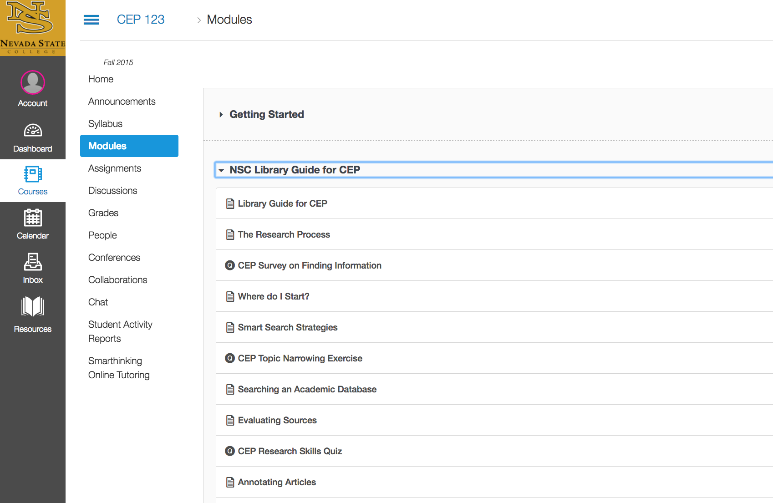
Notes:
Here is the CEP Library Guide module as it appears for students in an actual CEP course shell in Canvas. The module has a variety of content pages, tutorials, and assessments which cover the information literacy outcomes and assignment requirements of the course. Many of the pages are also in the discipline-specific modules, such as search strategies, but the CEP Library Guide also features a page on annotating articles, since this is often one of their assignment requirements. What really makes this Library Guide unique, however, is another series of pages in the module related to assessment. The module contains an initial survey on research style, an online topic narrowing exercise, a research skills quiz, and a module evaluation. Although the assessments were designed with points associated with them, they are all considered ungraded and will not affect the students’ grades, unless the instructor makes them required.
A major benefit of the Library Guide is that it can be conveniently moved in between any other course modules, which allows instructors to place it where they think it fits best within their course, such as adjacent to the initial assignment prompt or directly before the week that their students’ research assignment is due. Not only does this provide more context for the library instruction within the course, but being a self-paced module allows learners to approach the material at their own pace and take an active role in their own learning. Although ideally, an instructor would make the library module required at a certain point in the course, having the ability to discover or return to the content as the student requires it is one of the greatest benefits of the module.

Slide 15
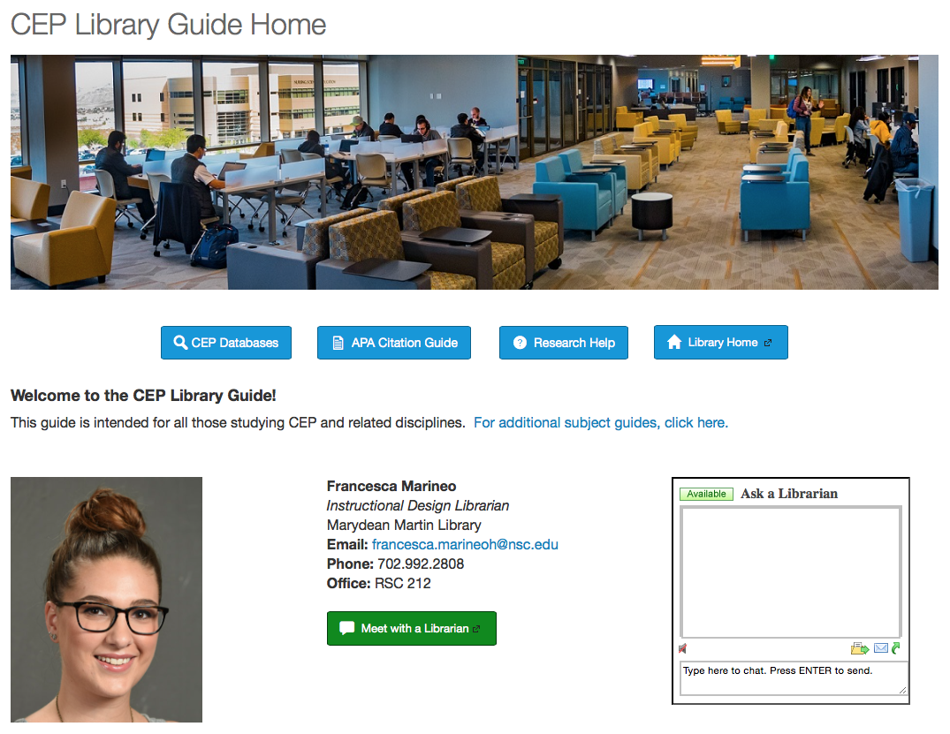
CEP Library Guide
Fall 2015 Case Study:
11 total sections (374 total students)
5 sections included Library Guide (130 student)
3 sections also had in-person instruction (63 students)
Notes:
The CEP Library Guide in Canvas was designed to replace in-person instruction sessions, however, of the eleven total sections of CEP in fall 2015, only five assigned the module, with three of those five sections requesting an in-person instruction session in addition to the module. The lack of implementation of the module was likely because of several challenges. First, feedback from instructors indicated that while they liked the idea of the online modules, they still believed that students benefit more from in-person interactions with the librarian. This is a common challenge with online education, even though many studies have shown that online information literacy instruction is just as effective at building IL skills as in-person instruction. Second, while the instructors were encouraged to import the module by the Director of CEP, they were not required to use it. This challenge is also present within the course sections in that only one instructor who imported the guide gave their students a participation grade for completing it. Despite this, many students voluntarily accessed the module and completed the various assessments.

Slide 16
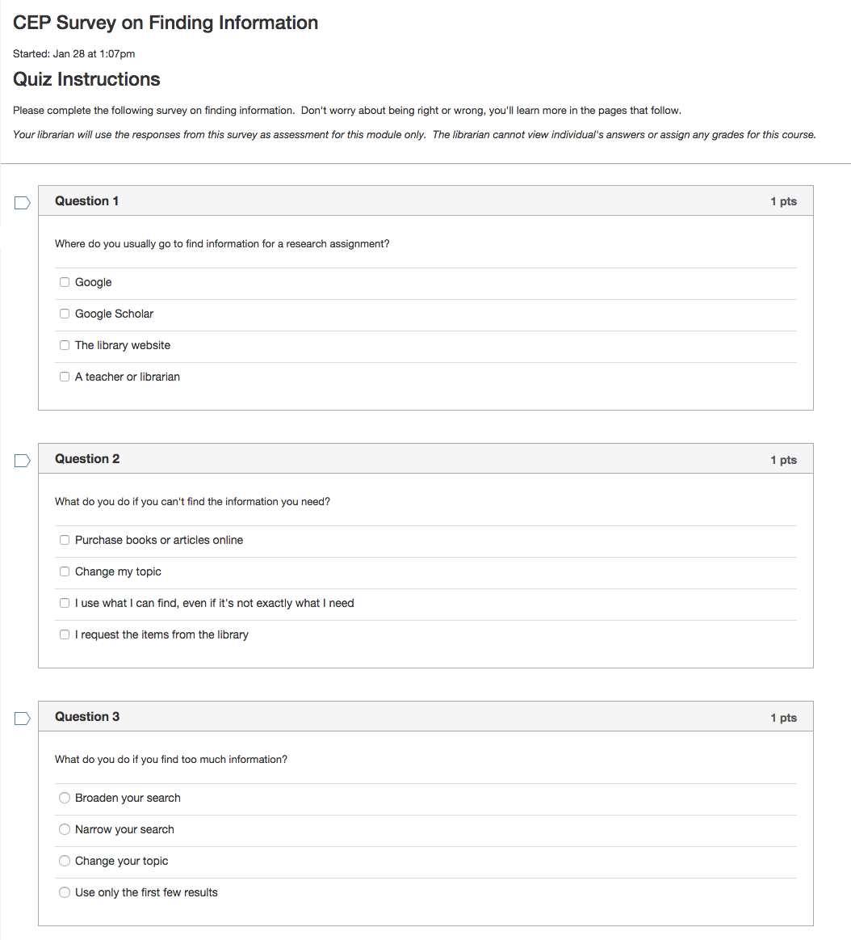
Notes:
Here is an example of one of the assessments in the Library Guide, the CEP Survey on Finding Information. Set up as an ungraded quiz, this survey gives us an idea of students’ current research style. As could be expected, most students answered that they usually go to Google to find information for a research assignment. This is very similar to a pre-test you might give during an in-person session, and it introduces students to the content that will come in the module. One great future of doing this within Canvas is that you can add comments for each answer to provide more information. For example, if they select Google Scholar as a place they find their research, a comment box will appear to remind them to make sure they have set up Library Links in Google Scholar.

Slide 17
Assessment of CEP Fall 2015
SIGNIFICANT
NOT SIGNIFICANT
Students who participated in the library module scored higher on their research assignments
Students who completed more sections of the library module used online library resources more
Students who used the library more scored higher on the research assignment
Differences in research assignment scores based on library instruction type were not significant
Students who participated in the library module did not significantly use online library resources more
Differences in online library use based on library instruction type were not significant
Notes:
With IRB approval and working with our Office of Institutional Research, we were able to pull the voluntary submission data from all of these assessments, as well as student participation in the module, and student grades achieved on their research assignments for all sections of CEP in the fall 2015 semester. We had a series of six research questions that we wanted to address, which looked at the relationships between participation in the Library Guide, student research assignment grades, library instruction type (either in-person and online, no library instruction, or online only) and students’ use of library resources, as measured by our EZproxy log data. At Nevada State College, we force EZproxy authentication both on- and off-campus, which gives us a comprehensive measure of resource use, especially because nearly all of our content is online. We provide this data to the Office of Institutional Research, who then anonymizes it and sends it back to us with other institutional data, in this case student assignment grades.
Tiffany LeMaistre, our Electronic Resources and Discovery Librarian, was an invaluable resource at this stage in the process. She performed a series of correlations, t-tests, and ANOVA tests on the CEP data, to answer our research questions. From the analysis of this data, three of our research questions had statistically significant results, and three were considered not significant. I will now share our significant results in a little more detail.

Slide 18
Students who participated in the module achieved higher grades on their research assignment
Notes:
First, we wanted to know if students who participated in the Library module did better on their research assignments, and as you can see here, they did.
Results indicated that students who participated in the CEP Library Guide module scored significantly higher on their research assignment than those who did not participate. We had a sample size of 128 students and the effect size was small to moderate for this test.
Since not every section of CEP used the module, or had in-person instruction, we also wanted to know if type of instruction received had an effect on assignment grade. We looked at library instruction type as the independent variable with three levels (no instruction, online instruction, online & in-person instruction), and research assignment grade as the dependent variable, however our results showed no significant difference between instruction type. For this test, we did have a very small sample, which may have influenced our results. Another question looked at the differences in online library use based on library instruction type, although, the results of this test were also not significant.
---
Result: SIGNIFICANT - Results from an independent samples t-test indicate that students who did not participate in the library module (M = .651, SD = .399) scored significantly lower on the research assignment than students who participated in at least one section of the library module (M = .806, SD = .271). The mean difference was significant, t (128) = -2.075, p = .020, r2 = .033.

Slide 19
Students who completed more sections of the library module used online library resources more
Notes:
We also tested whether or not students in CEP who participated in the library module used library resources more. Again, since our library in nearly all online, and we have students sign in with their institutional credentials every time they access online library resources, we have a very comprehensive measure of resource use. Unfortunately, there was no significant relationship between module participation and library use. Although a revised research question looking at whether more participation in the module led to more resource use did return positively significant results. We hope to measure this further in future semesters, hopefully with the instructors making participation in the module a requirement.
---
Results: SIGNIFIANCT - A Spearman correlation analysis between number of library modules completed and number of sessions in the online library revealed that there is a statistically significant weak positive relationship between them, rs = .157, n = 170, p = .02

Slide 20
Students who used the library more achieved higher grades on their research assignment
Notes:
Our final research question was looking at library use and research assignment grades and this is what you see in the second graph here. The number of online library sessions and grades on the research assignment were significantly positively related with a moderate relationship.
While the evidence suggests that there is a positive relationship between library use and instruction with research assignment grades, we are aware that this does not mean causation. For us, we hope that being able to demonstrate correlation will allow us to not only improve our instruction, whether through content or delivery, but also get further faculty and administrative buy-in and make further data-driven decisions to incorporate initiatives like this more broadly into the curriculum. I hope to have all instructors implement the guide and make it a requirement for students in the fall 2016 semester and do these tests again to see if that has an impact on any of our results.
The CEP Library Guide has been an excellent project to move towards more sustainable information literacy instruction at our institution, supporting student learning outcomes and providing access to library materials and services at the students’ point of need within the LMS. We will continue to implement the CEP Library Guide, making improvements, and assessing its impact on student success. From this guide, we have also created a series of discipline-specific guides, and with that, I will turn it back to Oscar, who will discuss our work in this direction so far.
---
Result: SIGNIFICANT - A Spearman correlation for the data revealed that the number of online library sessions and grade on the research assignment were significantly positively related with a moderate relationship (rs = .415, n = 295, p = <.001)

Slide 21
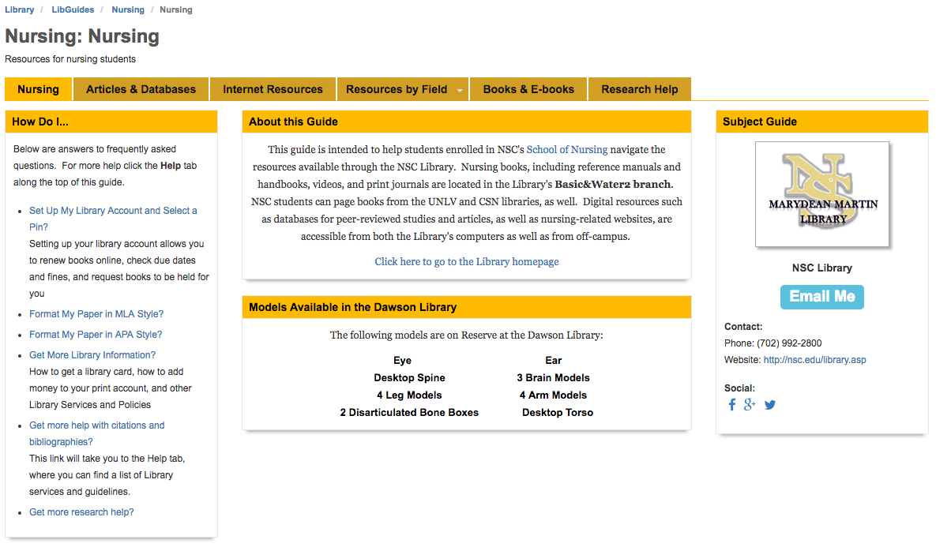
Transition to the LMS
Working with library staff
Evaluating LibGuides subject and course content
Reviewing Nevada State College academic offerings
Notes:
After we created the CEP guide, we began working on further integration into courses in the Canvas platform. To do this, we met as a department to decide what type of content should be moved over from LibGuides, what needed to be added, and what could be omitted. This involved looking at the concentrations offered at Nevada State College along with how they are currently supported by our existing library presence. Like the CEP module, our discipline-specific Library Guides are also available for faculty to import directly into their courses from Canvas Commons. In addition we maintain all of our Library Guides in our NSC Library Online public Canvas course, which was mentioned earlier. This way, students can still access the guides, even if any instructor has not imported one into their class. They are accessible through a custom Resources tab that links to NSC Library Online, as well as a variety of student support services, including the Writing Center and the Academic Success Center.
Before I show you the new nursing library guide, here is an image of the nursing LibGuide we had previously.

Slide 22
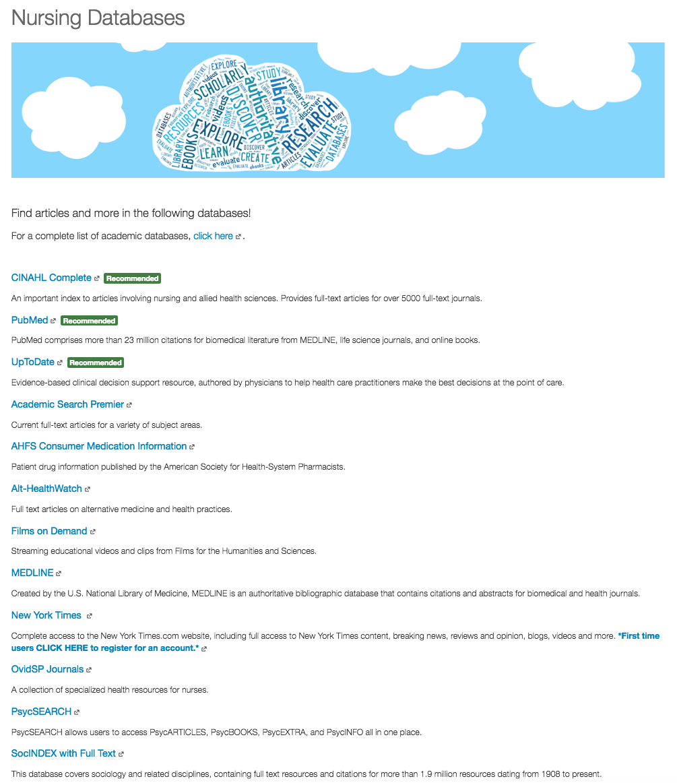
Library Guide Content
Welcome page with subject librarian, contact information and chat widget
Database listing
Search strategies such as Boolean operators
APA citation guide
Notes:
Although the content varies between each of the subject areas we selected, there are a few common elements.
First, each guide has a picture and contact information for the librarian responsible for it. Also, each has a listing of relevant databases, which is derived from the listing we have on the library website. This is an example from our nursing guide. As a cloud-based library, we try to incorporate this branding throughout our online presence.
To prepare students for database searching, we include content on Boolean operators and other search strategies on another page in the guide. Finally, there is a page on formatting citations in APA format, the style used by most of the campus.

Slide 23
Transition to the LMS - Tutorials
Increased production of tutorials to support subject areas
Academic Search Premier
JSTOR
PsycINFO
CINAHL
etc.
Incorporated search strategies module content into some videos
Notes:
At around the same time, we began producing tutorial videos on some of the more widely used databases in our collection. To reinforce the content on the library guide, some incorporate the search strategies discussed in the subject library guide so that students can see them in action. Also, some videos were split into two parts so that students could familiarize themselves with how the database works before learning how to request articles through ILL, for example. All of these videos are hosted on our YouTube channel. Although this is similar to the demos often done during in-person sessions, having the tutorials embedded within the guides allows students to return to them whenever they are doing their research.

Slide 24
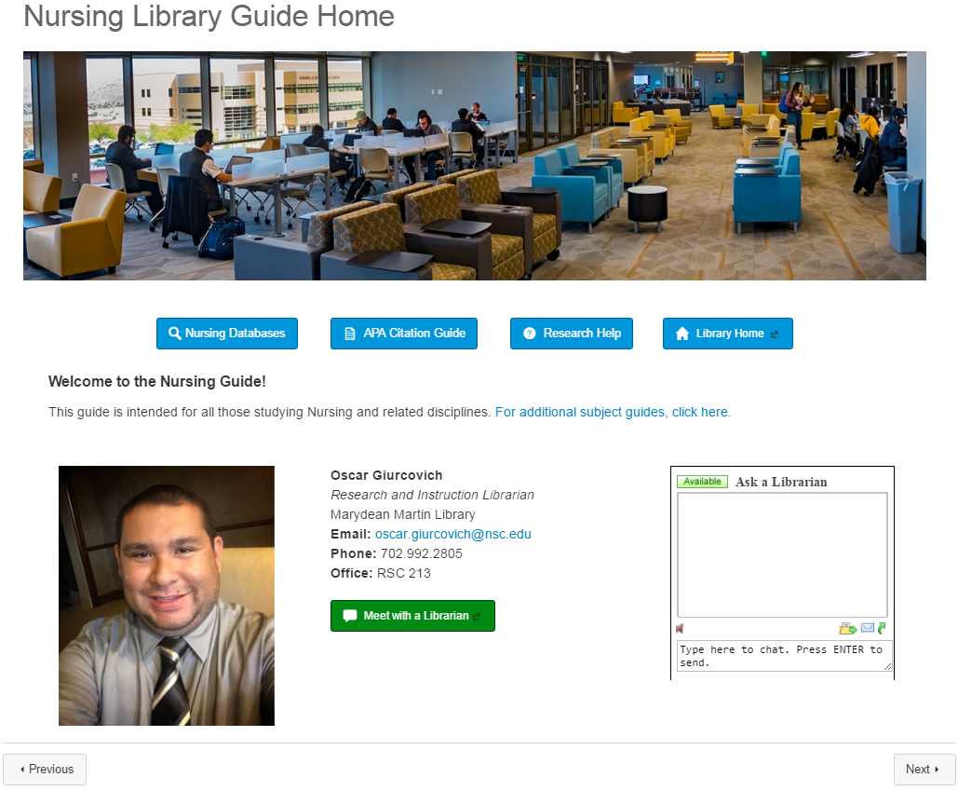
Notes:
Here is the nursing library guide. It is geared towards juniors and seniors who have been admitted into the nursing program and are taking major courses. As with the CEP module, the librarian’s picture and contact information are on the front page along with our chat widget. The nursing database list follows.

Slide 25
Notes:
Originally, we took some of the content from course LibGuides we had created for their research methods courses and directly copied and pasted it into a page for this module. However, last fall we visited a nursing and professional communication class and decided to revise the content used in previous semesters for a handout we gave during the session. That is what you are currently seeing here. This content is reviewed at a few different points in the nursing program. In a nutshell, this outlines the steps needed to form a complete nursing research question using the PICO model. From here, we show students what elements are needed in order to search for scholarly sources.

Slide 26
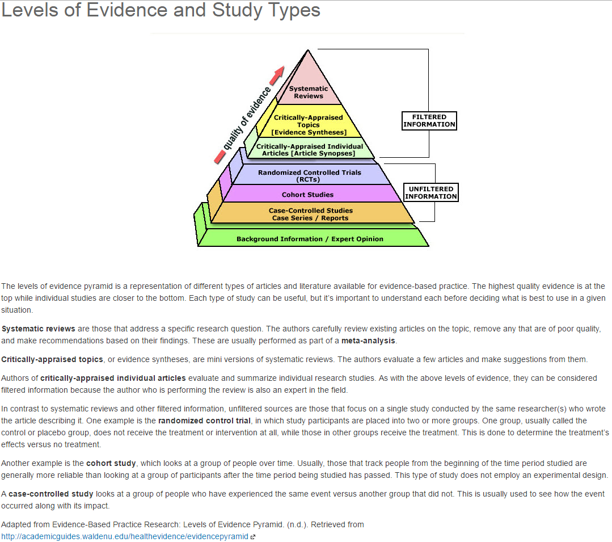
Notes:
The content on this page was also adapted from the previous LibGuide. I decided to include it so that students are aware of the different types of studies in evidence-based nursing to better target their research and decide what sources are most suitable for them. This is not something we have reviewed during an ILI session, but I think it serves as a refresher and also to better connect the link between what is taught in class and how it relates to research.

Slide 27
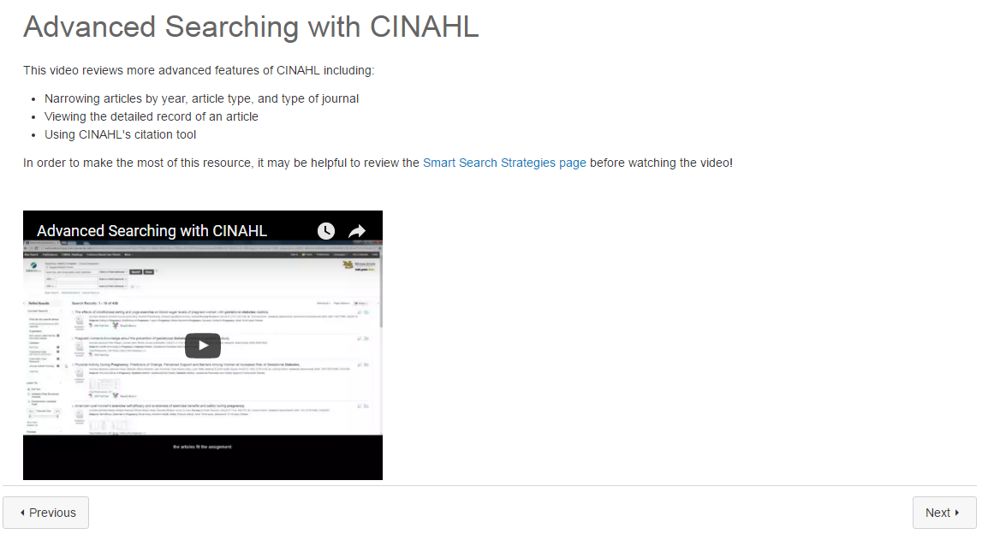
Notes:
As mentioned, we incorporate a search strategies page and a video tutorial of a discipline database. In the case of this advanced CINAHL tutorial, it came about after a nursing professor asked me to make a video for her online class. I took the opportunity to make it more sustainable by modifying the content for a broader audience. The remainder of the module pages are those that are used in many of the other library guides we’ve created.
Although the subject library guides are quite general by nature, their complete integration with Canvas makes it easy to create customized content, both at the module and page level. Most importantly, we are able to make copies of either an entire module or just a page from an existing guide as a template.
Using the nursing library guide as an example, it can be easily modified to become a custom module for an evidence-based nursing course. The instructor can request content devoted to specific features of a database students are to use for an assignment. Since this would not be covered in a current video, I can then work with the instructor to see if a custom tutorial or a page with screenshots explaining these features would be the most helpful. Also, the instructor can remove the pages with tutorials on a database students will not be using for the course assignment. At Nevada State College, we offer this particular course completely online, so with the help of a close faculty/librarian relationship, we can include assessment components. As Francesca mentioned, these could be made part of the course grade while eliminating the need to hold a synchronous library instruction session.

Slide 28
Lessons Learned - Successes
Positive feedback from instructors and institution
Faculty interest in using library guides in their courses
Opportunities for collaboration and expansion through discussion
Sharing our work
Notes:
Now that we’ve shared some of the specifics of our Library Guide modules with you, I wanted to expand on some of the successes and opportunities that we have had with this project, as well as provide some recommendations for implementing a similar initiative at your institution.
Aside from the data Francesca shared about the success of the CEP Library Guide, we’ve received quite a bit of positive feedback from instructors and administrators.
The Director of CEP provided feedback on the course guide saying, “I think it is spectacular. Well designed, thoughtful, and full of great information. Francesca did a great job facilitating the creation of this module and was right on target with what the student's needs were.” Another instructor left this review on the Psychology Library Guide in Canvas Commons, which reads “This is amazing! I was planning on spending hours creating a search guide for my Advanced Research Methods class, but the Psychology Library Guide module took me 1 minute to import into my class and is better than anything I would have created. Thanks!!”
In the early stages of designing the discipline-specific modules, during faculty consultations for library sessions, instructors were happy to see that a resource like this was being developed. They expressed great interest for when they would be completed and additional disciplines added. We were also asked to share the project at one of our Faculty Senate meetings, after which one instructor asked that we design a guide for one of the disciplines we had not yet covered so that he could add it to all of his courses right away.
Beyond our institution, we have been able to present on various aspects of this project at a range of conferences, including the John N. Gardner Institute’s Gateway Course Experience Conference earlier this month in Atlanta and at the upcoming Library Instruction West Conference this June in Salt Lake City. Francesca and our Instructional Designer are also contributing a book chapter to a forthcoming ACRL publication.

Slide 29
Lessons Learned - Opportunities
Increase research across campus
Outreach about resources and services
Facilitate collaboration with faculty
Notes:
Along with our many successes with this project, we also recognized several opportunities that we could pursue to have a greater impact on student outcomes. As an emerging research campus, we see Library Guides in Canvas as a way to initiate conversations about research at Nevada State College. To that end, we hope to engage with faculty to design assignments for their courses to align with information literacy outcomes. Also, we are continually working on creative ways of transitioning our students and faculty to a completely digital library environment. Since the transition, we have seen an increase in our digital collection over use of our previous print collection. Finally, our faculty has a very strong independent spirit and is used to doing things themselves. As you saw in the previous slide, one faculty member was about to make her own research guide, but was thrilled to find out something like this already existed. We imagine that there are still many instructors that are unfamiliar with the various resources and services we offer. It is our hope that by integrating further within the LMS and making our instructional services more visible, we can facilitate more collaborative relationships with faculty while making the library guides an integral part of the curriculum.

Slide 30
Recommendations
LibApps LTI Tool for Canvas, Blackboard, Moodle, etc.
Collaborate with faculty you already work with
Start small, but in a program with impact
Notes:
Considering these successes and opportunities, we want to offer some recommendations for implementing a similar initiative at your institutions. For us, it made sense to start from scratch, departing from LibGuides, and designing our new Library Guides directly within the LMS. However, if you already have a very robust and well-maintained collection of LibGuides, these can still be made more pertinent to courses by integrating them within the LMS. As mentioned, LibApps has developed a LTI that allows you to integrate LibGuides, LibChat, and other library services and resources directly into any compliant LMS. It was just upgraded this past month and is definitely something worth looking into if you are integrating into the LMS.
For us, it was really beneficial to start out with one course, CEP, to gauge reception of a fully integrated module and to generate some data on the impact of the guide on student outcomes in order to build faculty and administrator buy-in. CEP was also a great starting point due to our good relationship with the director of the program, because, as we emphasized, collaboration was imperative to our project.
Starting a project like this with faculty members that you are already working with and have a positive relationship with, whether it’s for in-person sessions, embedded instruction, or initiatives, helps to make the process smoother and honestly, more enjoyable. With those small successes, they start spreading the word, and by taking advantage of opportunities to speak with faculty across campus, such as through a professional development session, faculty senate, or meetings of the schools, you can scale the project more broadly into the curriculum.
With that, I will turn it back to Francesca who will wrap things up by sharing some of our plans with this project moving forward, and then we will have some time for questions.

Slide 31
The Future
New positions, new possibilities
Continue work with CEP
Additional support for new CEP for TRIO-SSS
Notes:
In close, I wanted to share some of the exciting initiatives we have planned coming up at the Marydean Martin Library. Shortly after I started at Nevada State College last August, an organizational shift in our Office of Instructional Technology brought about by the departure of our instructional technologist meant that the library had to take on some additional responsibilities within the LMS. The campus instructional designer came under our department, and the new instructional technologist likely will, as well. We are also in the process of hiring a second instructional design librarian. These changes in roles and responsibilities have brought about many new opportunities for our library, particularly in regards to our interaction with Canvas. Although this was not the case when we started designing our Library Guides, it has definitely helped the process since. As our institution grows and new positions and organization follow, we hope to continue to play a critical role in supporting student success through the LMS.
We will of course continue to work with our CEP program, using the data and feedback from last semester’s inaugural integration to improve the content, delivery, and hopefully participation. Also, our institution has recently began offering a federal TRIO program for student support services, which provides tailored opportunities for academic development, assists students with basic college requirements and serves to motivate students toward the successful completion of their postsecondary education. As part of this program, a new 3-credit CEP course is being developed and I met with the director of this program to discuss designing customized library instructional resources for this new CEP course, as well as other library services for the TRIO –program as a whole.
Additionally, we will continue to build our discipline-specific guides and collaborate with faculty to design more customized course-specific content. Aside from Library Guides, we are also pursuing additional initiatives that can build upon the success and optimize the opportunities of this project.

Slide 32
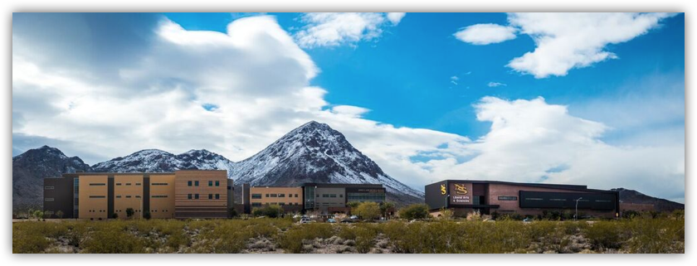
The Future
Further assessment in collaboration with IR
New opportunities within Canvas
Notes:
Through this project we have also strengthened our relationships with other departments on campus, such as the Office of Institutional Research, which made the assessment of this module so successful. We are going to continue to look at use data and instructional interventions to discover additional opportunities for implementing information literacy more sustainably across the curriculum. For example, we mentioned a forthcoming survey on research assignments current being administered on our campus and holding a faculty institute where we work intimately with select faculty to design or redesign a research assignment for their course.
We have also started working with our School of Education on integrating outcomes into Canvas. This project came about when the Dean of Education reached out looking for a way to measure achievement of student outcomes based on standard assignments given by his faculty. Although not traditionally under the realm of library support, having taken on the role of LMS admin and support for at least a temporary amount of time has provided us with new opportunities to connect with faculty and our schools, which we hope will continue and grow as we promote Library Guides and our other instructional initiatives.
On that note, we hope that our presentation here today has inspired you and provided you with a foundation upon which you can pursue similar initiatives at your campus. Providing sustainable and effective information literacy instruction is a goal that many of us are currently striving towards, particularly as one-shot demand exceeds available staffing and the continuing imperative to conduct meaningful assessment requires innovative ways of measuring student outcomes. Integrating within the learning management system has provided us with a new lens for achieving this goal, providing both sustainable and measurable instruction through Library Guides in Canvas.

Slide 33
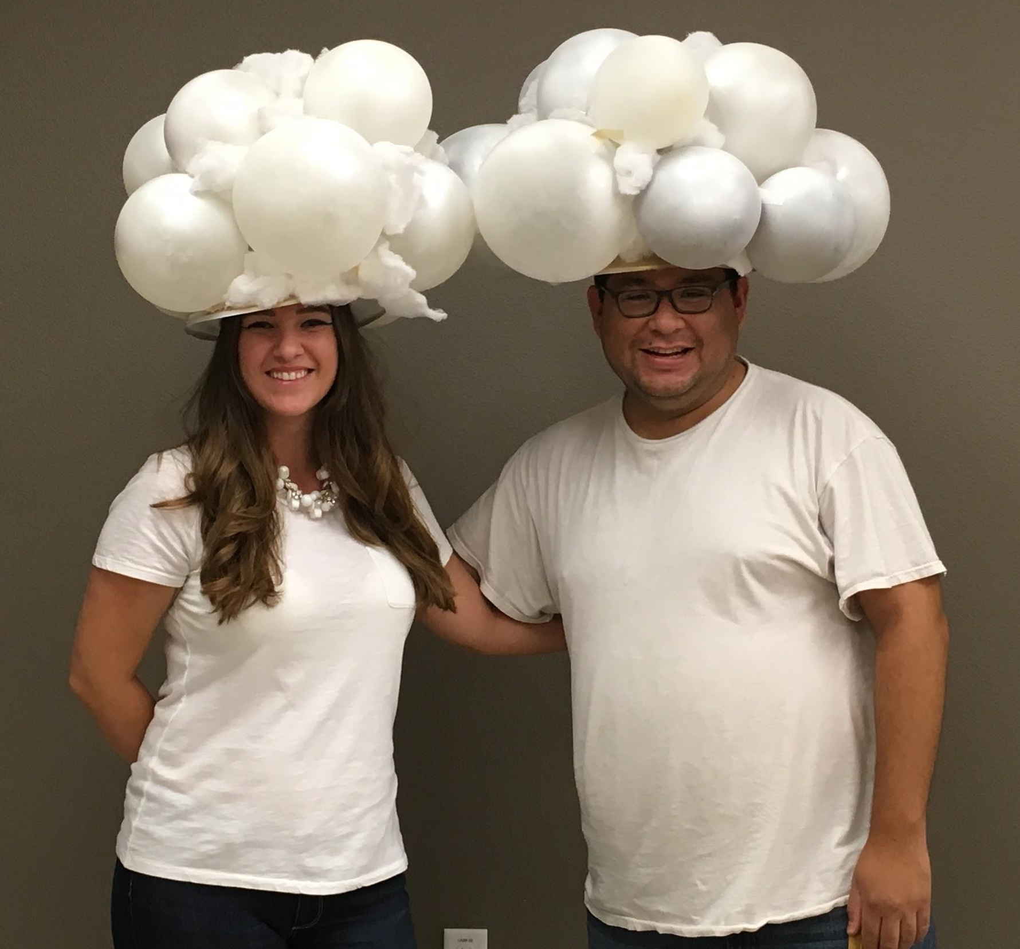
Questions?
Thank you!
Francesca Marineo
francesca.marineo@nsc.edu
Instructional Design Librarian
Oscar Giurcovich
oscar.giurcovich@nsc.edu
Research and Instruction Librarian
Notes:
Thank you so much for coming today! We now have some time for questions, but please feel free to contact us after the conference, as well!

Slide 34
References & Additional Resources
Burke, J., & Tumbleson, B. E. (2016). Learning management systems : Tools for embedded librarianship (Library Technology Reports, vol. 52, no. 2). Chicago, Illinois: ALA TechSource.
Johnston, N. (2010). Is an online learning module an effective way to develop information literacy skills? Australian Academic & Research Libraries, 41(3), 207–218.
Mery, Y., Newby, J., & Peng, K. (2012). Why one-shot information literacy sessions are not the future of instruction: A case for online credit courses. College & Research Libraries, 73(4), 366–377.
Mune, C., Goldman, C., Higgins, S., Eby, L., Chan, E. K., & Crotty, L. (2015). Developing adaptable online information literacy modules for a learning management system. Journal of Library & Information Services In Distance Learning, 9(1-2), 101–118.
Southwell, K., & Brook, J. (2004). Embedded assignment guides - Point of need instruction on the web. Georgia Library Quarterly, 41(1), 5–8.
Springshare. (2016). Why LibGuides CMS? LTI Integration. Accessed from http://buzz.springshare.com/producthighlights/whylgcms/lti
Zhang, Q., Goodman, M., & Xie, S. (2015). Integrating library instruction into the course management system for a first year engineering class: An evidence-based study measuring the effectiveness of blended learning on students’ information literacy levels. College & Research Libraries, crl15–692.

