Slide 1
ReFraming Backward Design: How to Revive Library Instruction for Student Success
Faith Bradham | Reference Librarian | Bakersfield College
Notes:
Brief intro of yourself, 30 second thesis statement
1-2 minutes

Slide 2
Backward Design + ACRL Framework
IF: Backward design is defined as a 3 part process of 1. Identifying desired results, 2. Determining acceptable evidence, and 3. Planning learning experiences and instruction (1).
AND: The ACRL’s Framework is informed by Wiggins & McTighe’s focus on essential concepts, and consists of “conceptual understandings that organize many other concepts and ideas about information, research, and scholarship into a coherent whole” (2).
THEN: What is more appropriate than using the Framework as an essential aspect of the goals/outcomes we work toward when planning library instruction?
1. Grant Wiggins and Jay McTighe. Understanding by Design. (Alexandria, VA: Association for Supervision and Curriculum Development, 2004).
2. ACRL Framework. 2014. http://www.ala.org/acrl/standards/ilframework.
Notes:
3 minutes

Slide 3
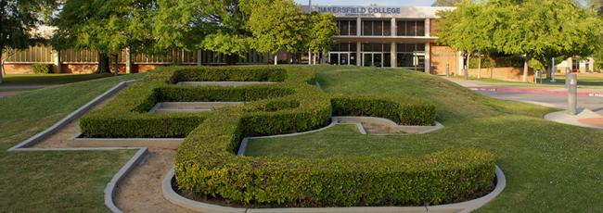
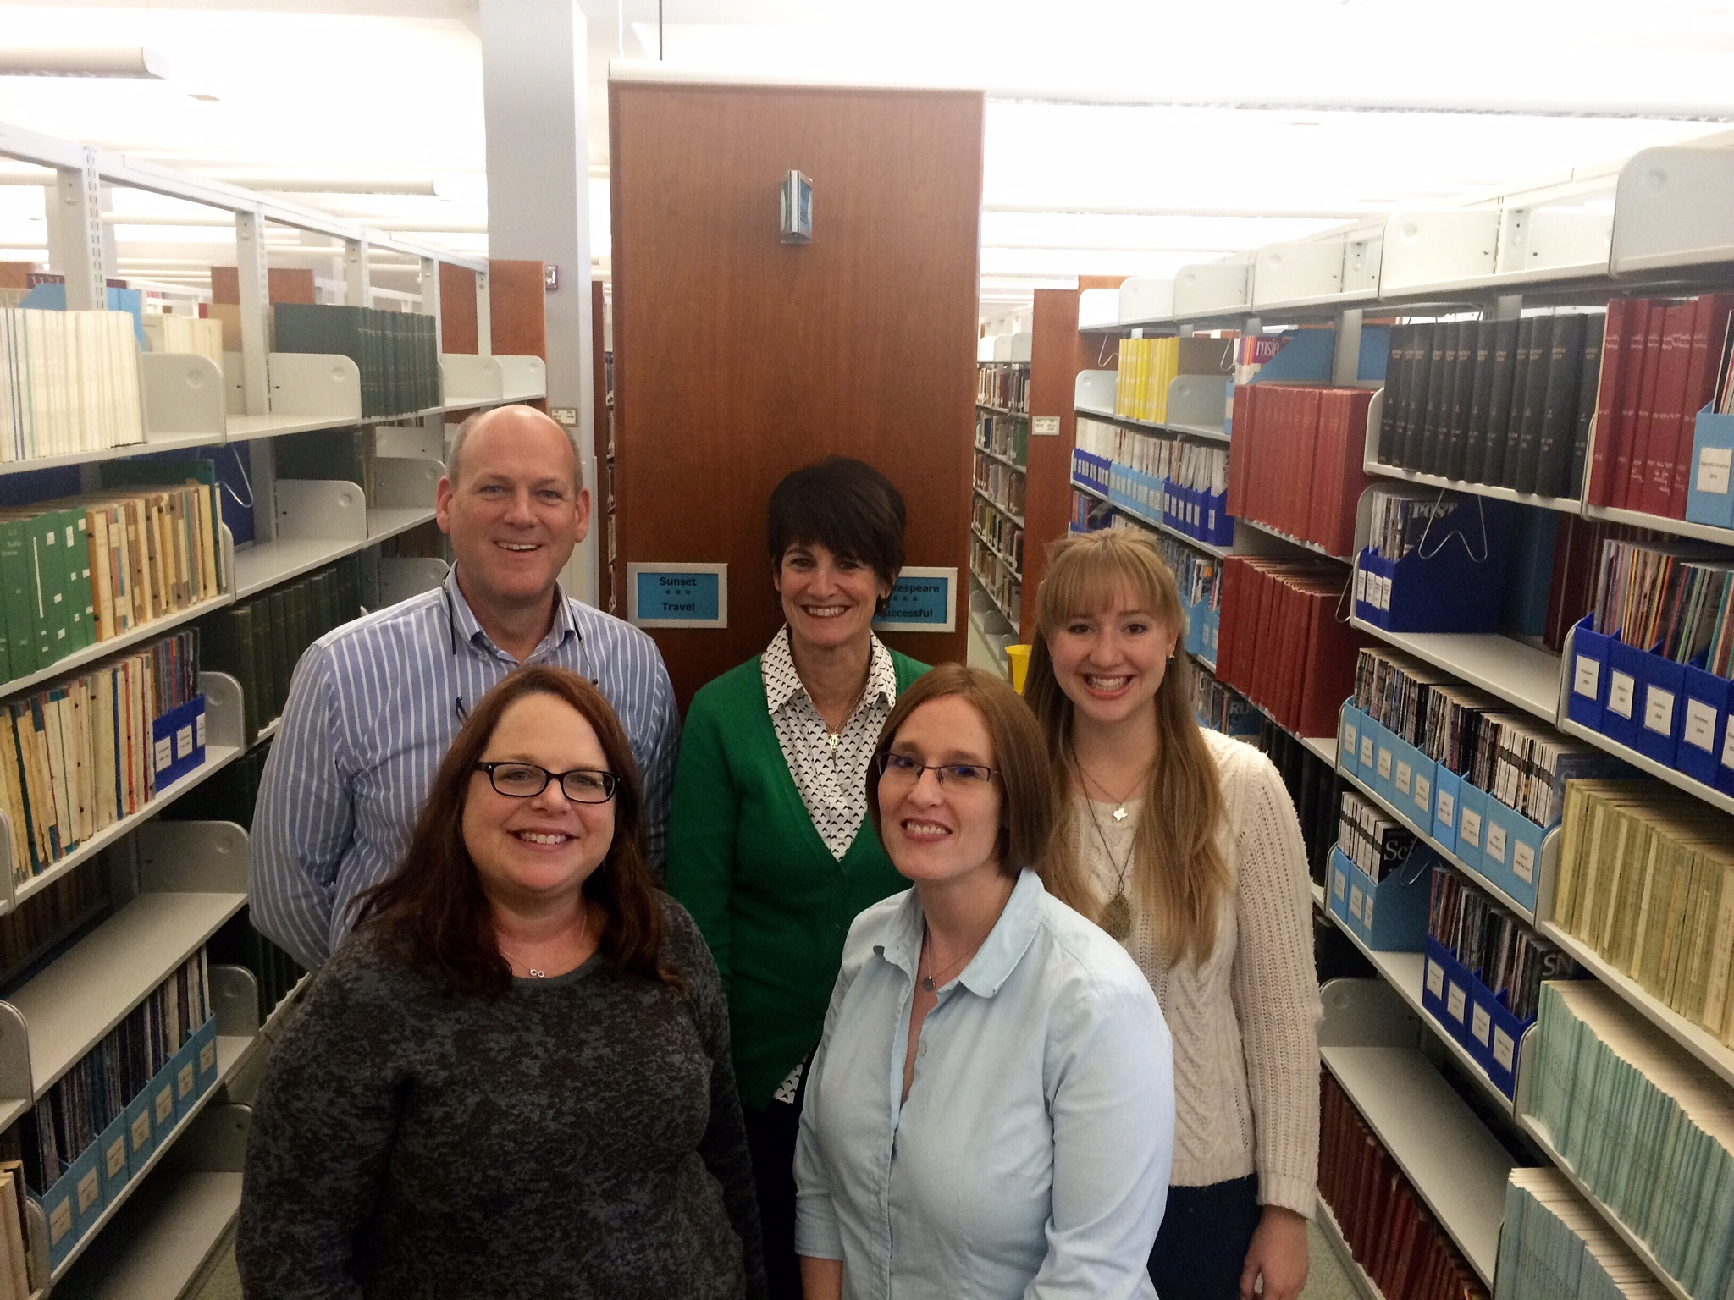
Bakersfield College and Grace Van Dyke Bird Library
BC student Profile
Grace Van Dyke Bird Library
Notes:
2-3 minutes total

Slide 4
State of the pre-Framed LIBR B1
Initially taught as a traditional bibliographic instruction course, but librarians quickly realized that was above the ability levels of our students.
Reaction: scale back to make learning as easy as possible for students.
Some librarians now provide explicit step-by-step instructions for every single assignment, and include quizzes and additional homework beyond the major assignments.
Problem: removing much of the critical thinking process means that students still aren’t grasping some of the concepts and their applications.
Students (and faculty!) don’t understand the value of library instruction and why it is important for their specific, individual goals.
Dilemma: how can we convey the essential elements of research in a way that challenges and interests students without overwhelming them?
Notes:
2-3 minutes total

Slide 5
LIBR B1: Introduction to Library Research
Assessment Map
Notes:
1 minute
Institutionally mandated outcomes

Slide 6
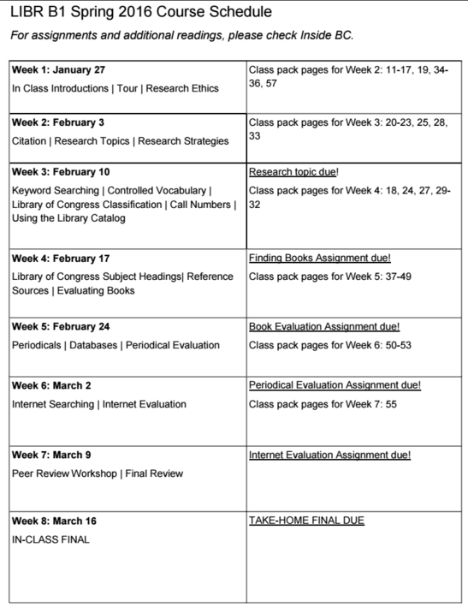
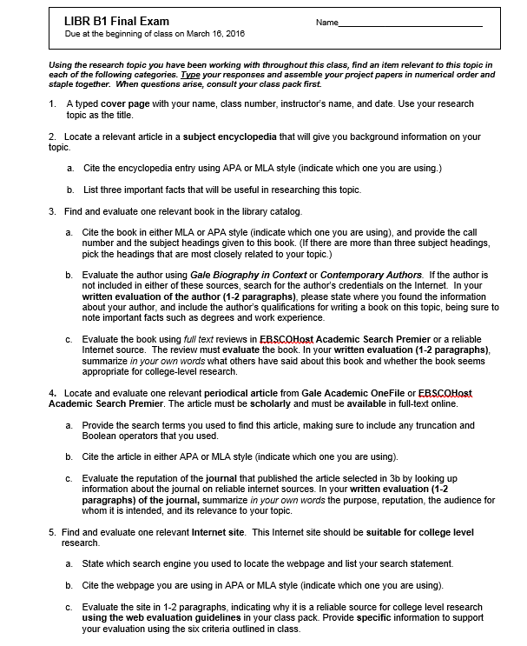
Departmental Goals
Notes:
1 minute

Slide 7
Making Connections: Institutional Learning Outcomes
ILO: Think critically and evaluate sources and information for validity and usefulness.
Frame: Searching as Strategic Exploration/Authority is Both Constructed and Contextual
ILO: Communicate effectively in both written and oral forms.
Frame: Scholarship as Conversation
ILO: Demonstrate competency in a field of knowledge or with job-related skills.
Frame: Research as Inquiry/Information Creation as Process
ILO: Engage productively in all levels of society—interpersonal, community, the state, the nation, and the world.
Frame: Information Has Value

Slide 8
Making Connections: Student Learning Outcomes
SLO 1: Demonstrate an understanding of the legal and ethical issues of information, including documentation and plagiarism.
Frame: Scholarship as Conversation
SLO 2: Locate relevant information using keywords and controlled vocabulary, Boolean operators, truncation, and other advanced search methods.
Frame: Searching as Strategic Exploration
SLO 3: Evaluate the credibility and quality of information using established criteria.
Frame: Authority is Constructed and Contextual
SLO 4: Employ effective research strategies to locate appropriate information resources in the library and online to acquire knowledge of a research topic.
Research as Inquiry

Slide 9
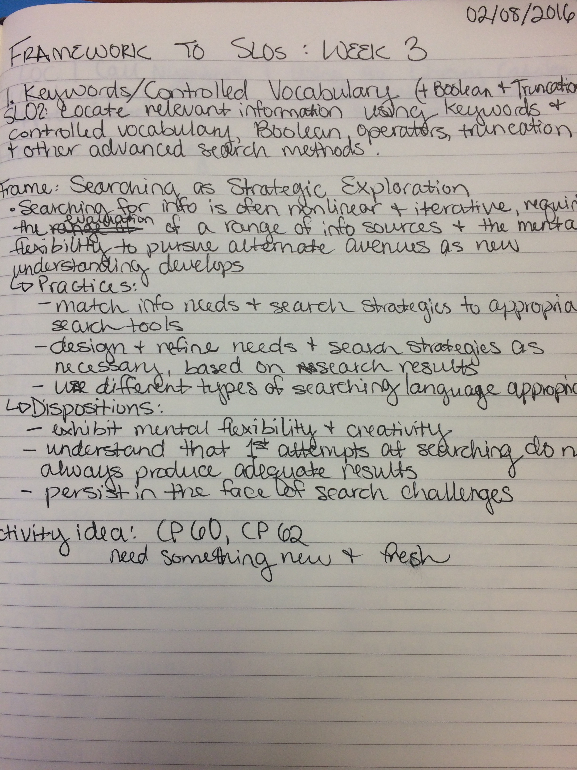
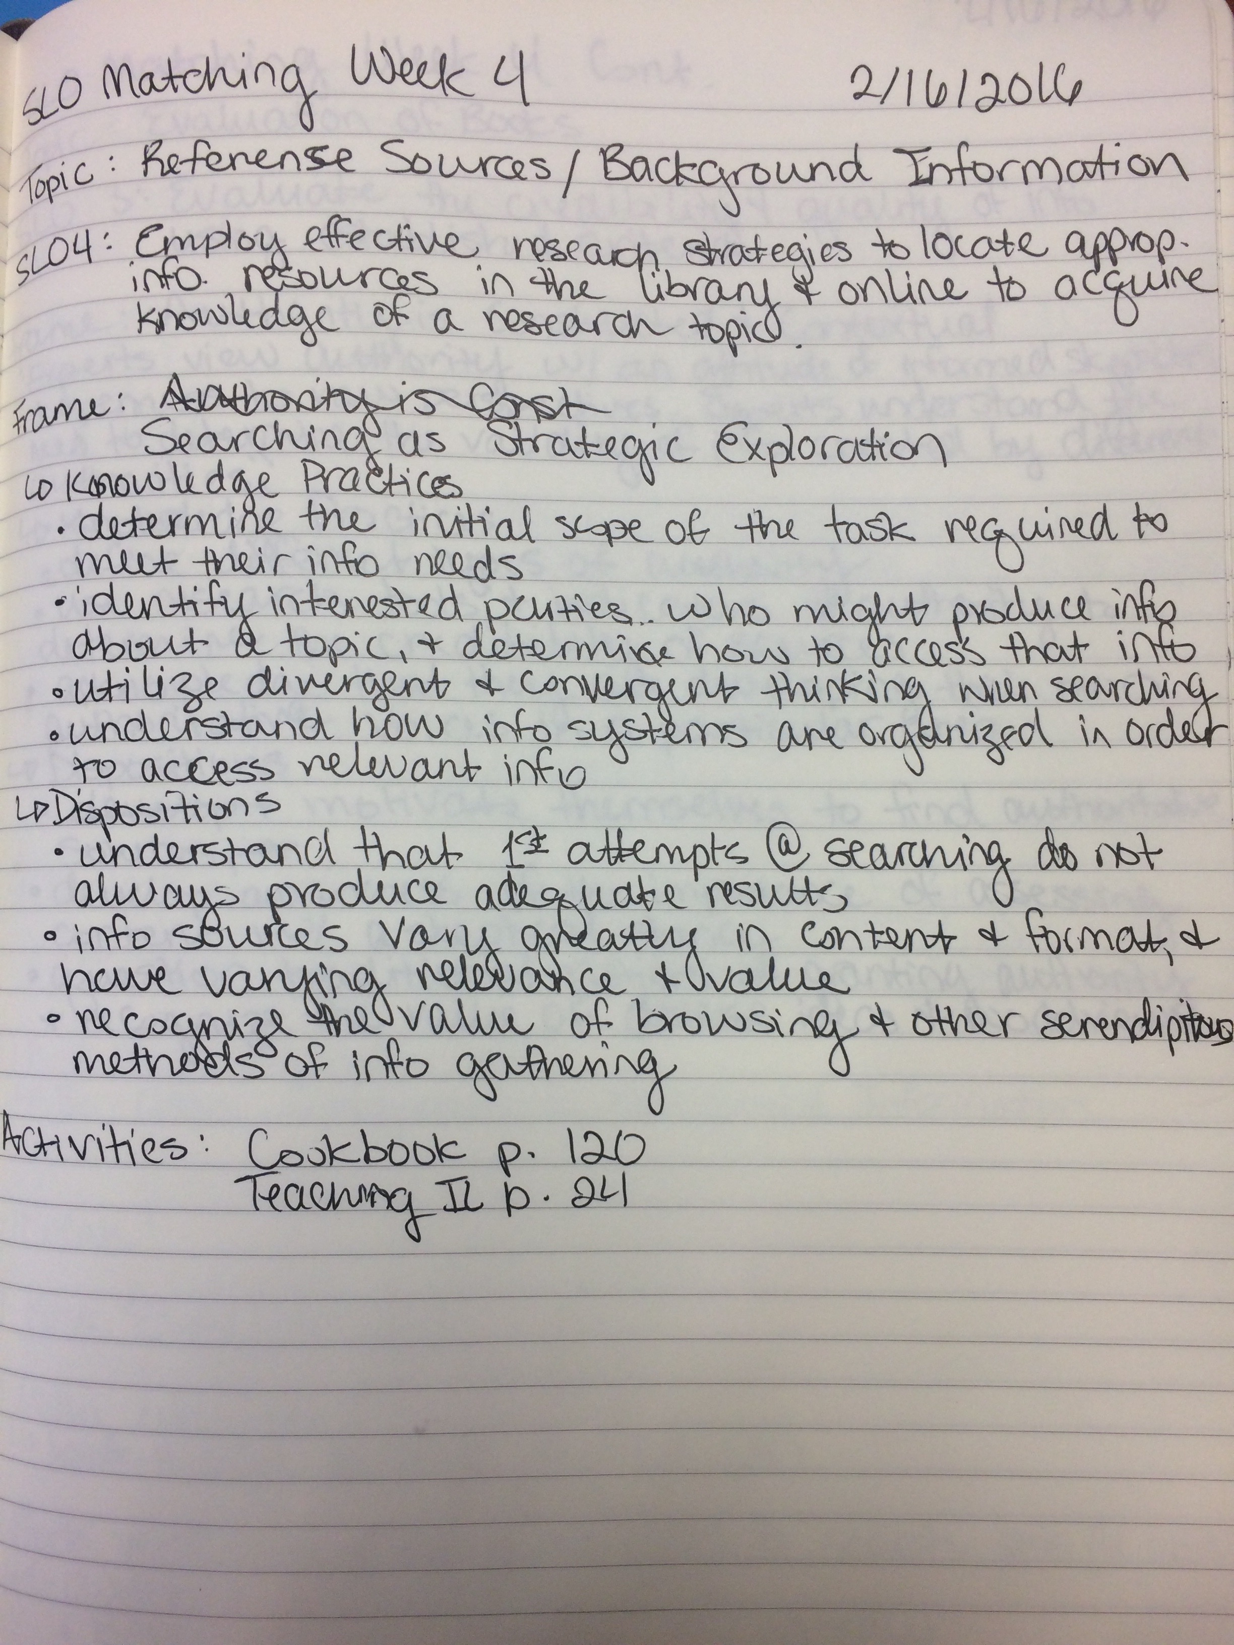
Making Connections: Weekly Outcomes

Slide 10
The Nitty Gritty: Learning Activities
Introduction/Paraphrasing Practice
Citation Creation
Database Discovery Project
Evaluation Jigsaw
Learning activity resources used: The One-Shot Library Instruction Survival Guide, Teaching Information Literacy: 50 Standards-Based Exercises for College Students, The Library Instruction Cookbook
Notes:
Framework applicable learning activities DON’T have to be completely new and unique to your and your class—they just mean you need to be looking for learning activities that incorporate Framework principles and threshold concepts!

Slide 11
Quantitative Assessment
70% of the class received a B or above, while 100% of the class passed the course.
Other section passing rates:
90%
71%
Notes:
3 minutes

Slide 12
Qualitative Assessment
What worked:
Changing my teaching language
Active learning
What didn’t work:
Static learning (leftovers from previous librarians)
Takeaway:
Although I did have some students who struggled with comprehension, the majority of my students sailed through the course with relative ease and quickly grasped concepts that my colleagues’ students did not.
For Fall 2016, I will:
Further simplify the assignment structure so that concept application is more understandable for students
Incorporate even more active learning and less podium instruction
Notes:
3 minutes

Slide 13
Questions?
Faith Bradham
faith.bradham@bakersfieldcollege.edu
Notes:
5 minutes

Slide 14
Your turn! Discussion & Brainstorming

